Slide 1
StarBase Intensity Interferometry Update
D. Kieda, N. Matthews, N. Traeden,
J. Skowronek
University of Utah
SII Workshop May 13, 2014

Slide 2
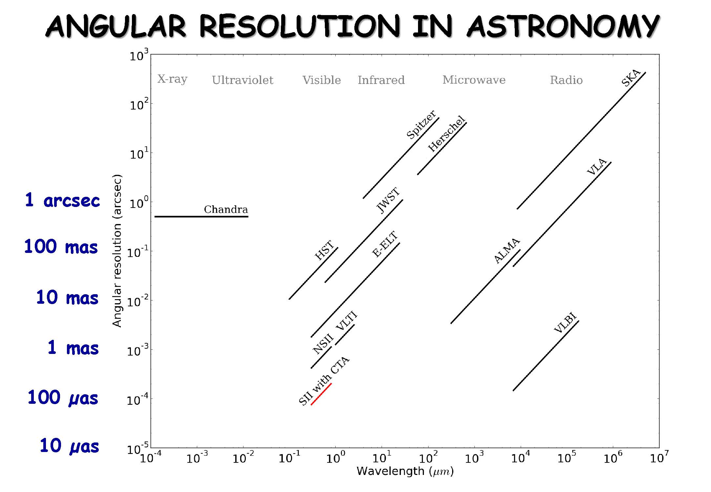

Slide 3
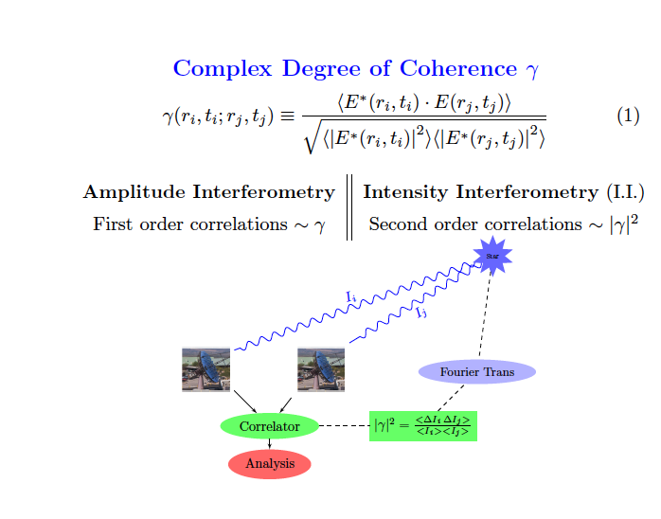

Slide 4
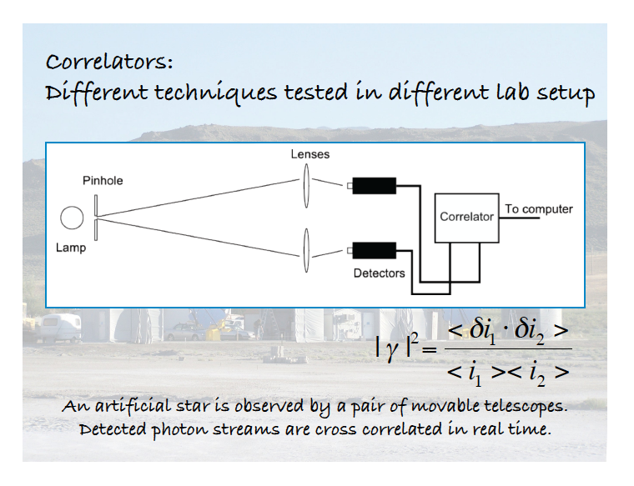

Slide 5
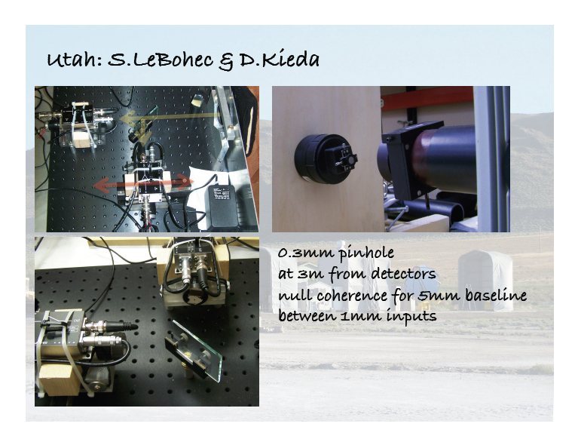

Slide 6
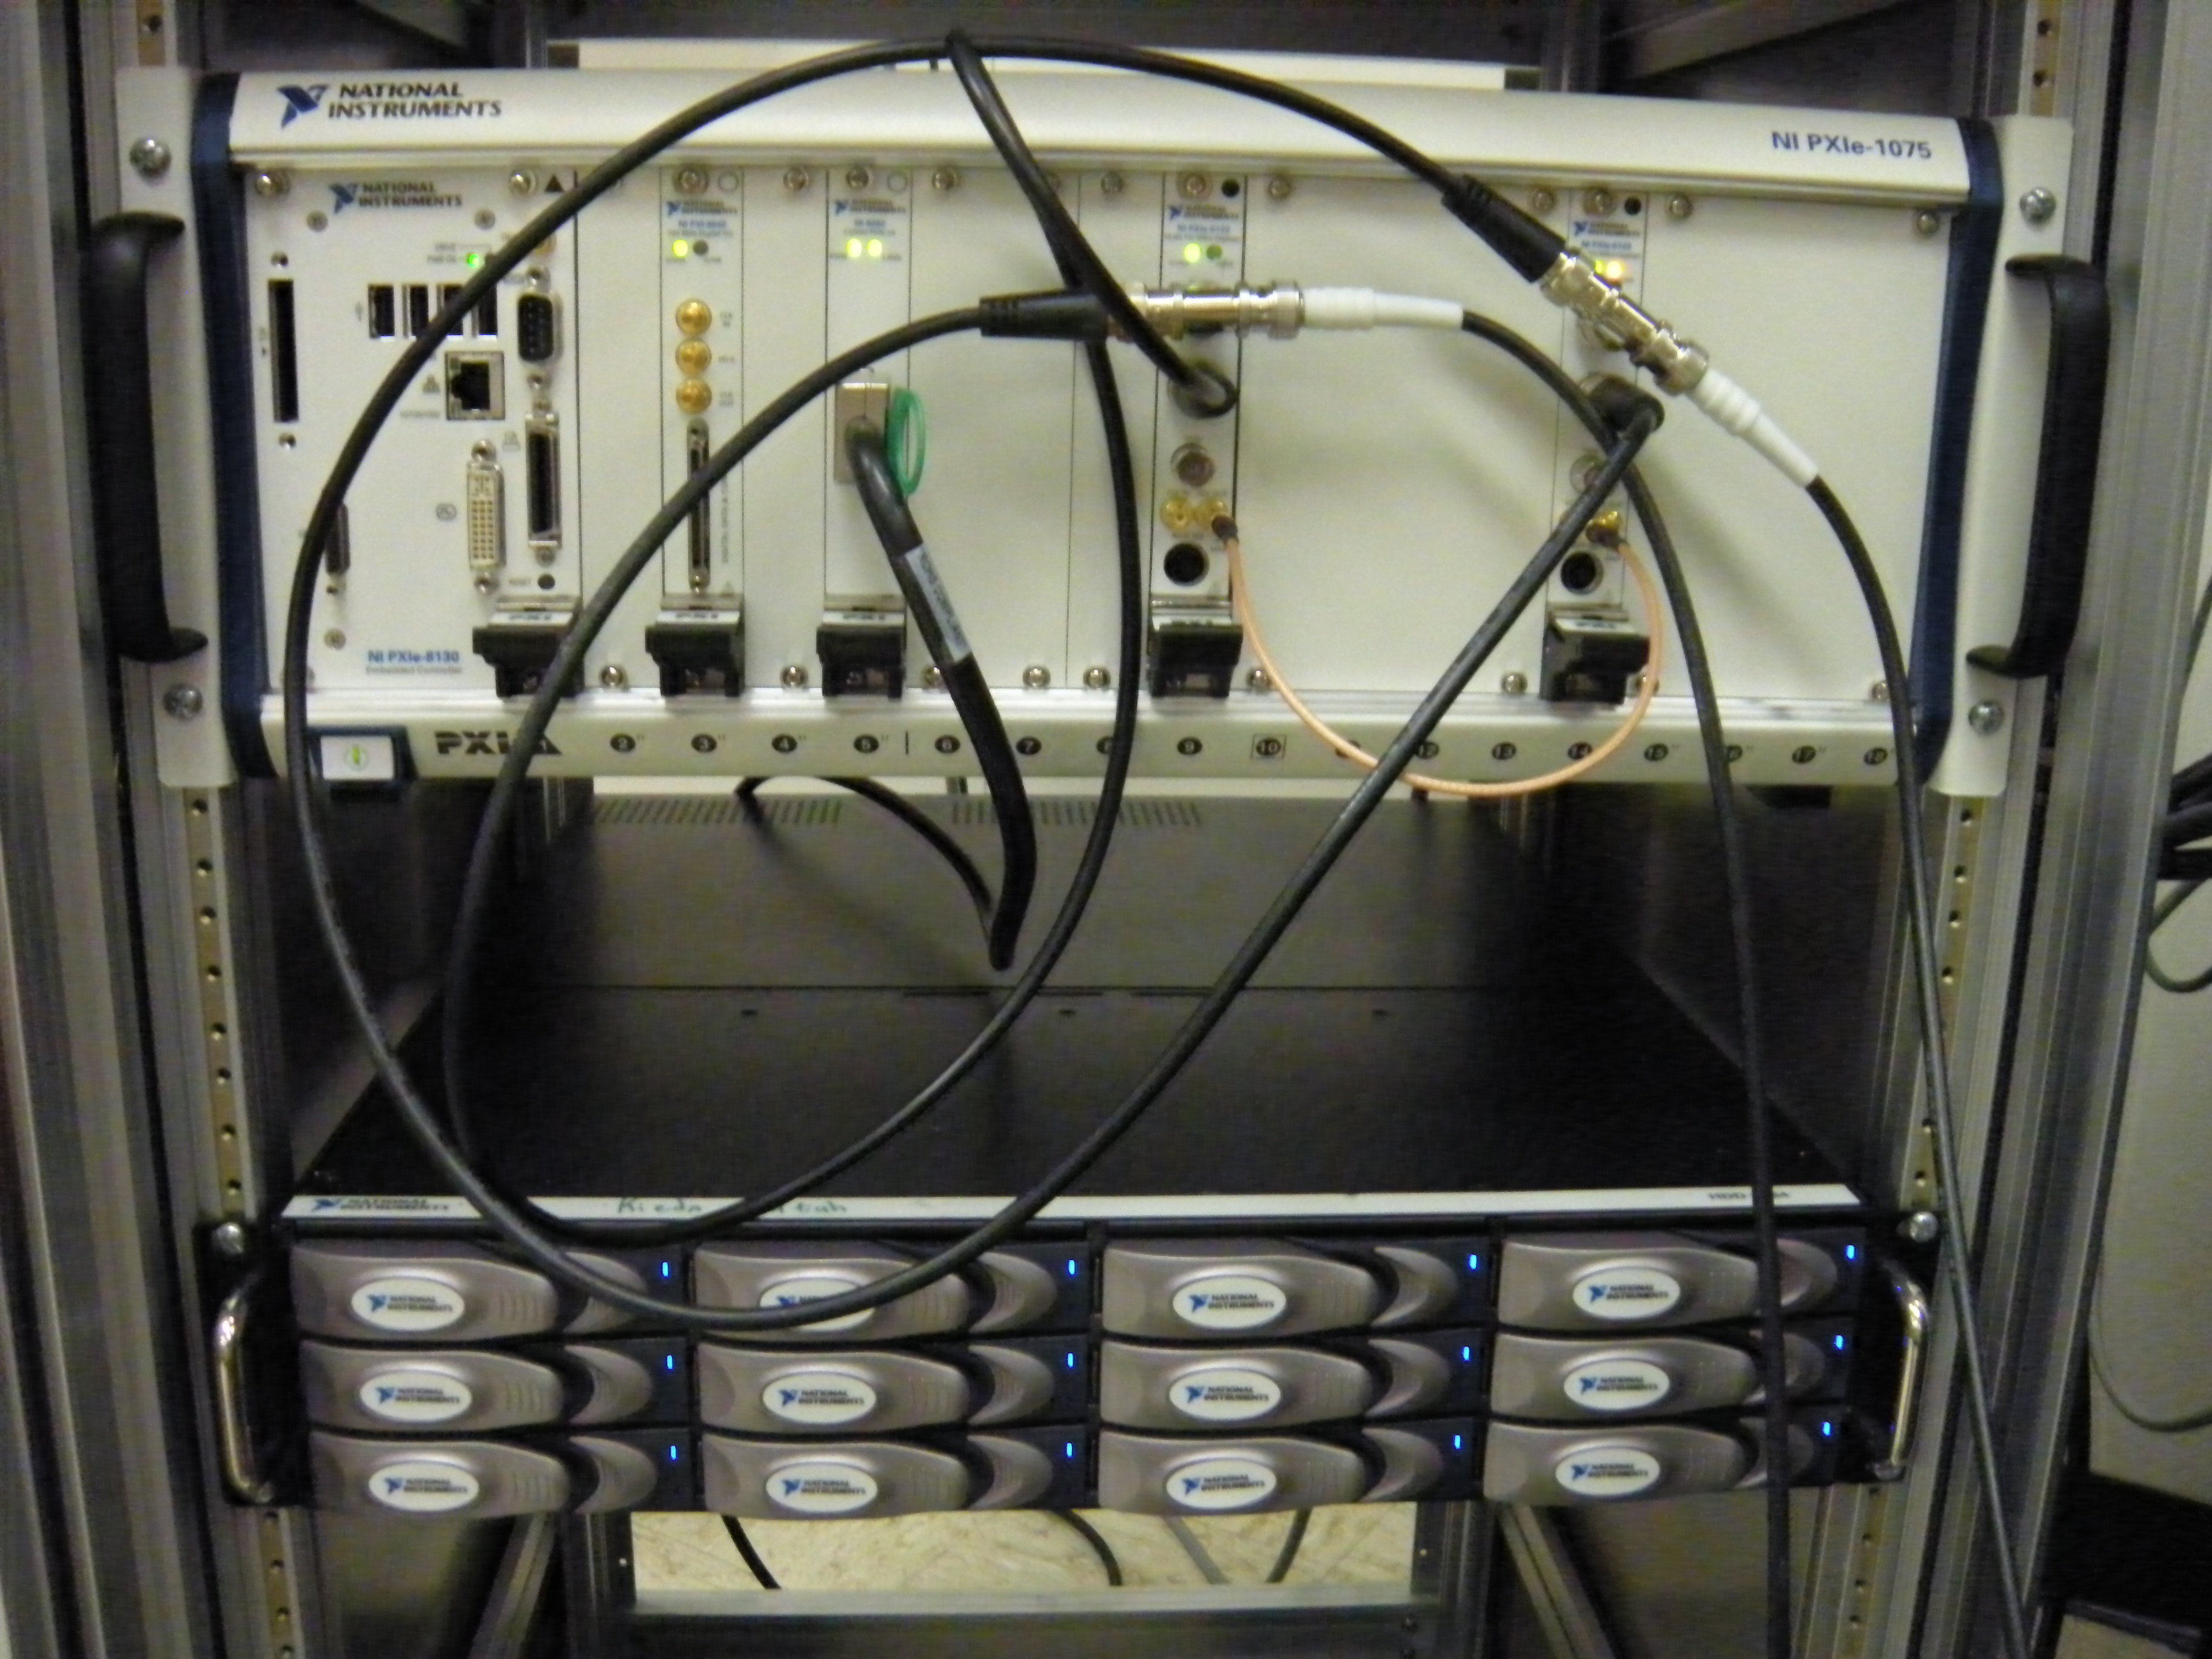
Digitizer System
NI Flex-Rio digitizer Digitizer (250 Mhz sampling) & Virtex5 FPGA Front end (4 channels, 14 bit resolution (Truncate to 8 bit))
Record to high speed 12 TB RAID system (750 Mbyte/sec)
Able to stream continuously for >6 hours
Periodic GPS Time Stamp of FADC clock to better < 4 nsec rms

Slide 7
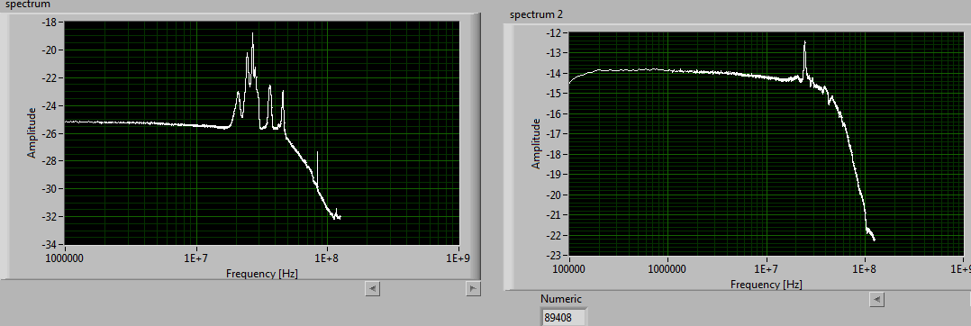
Record all Streaming data: GPS timestamp
Post Processing (2, 3, ..N Telescope Coorrelations)
FFT Analysis
Develop/Apply Digital Filters to increase S/N

Slide 8
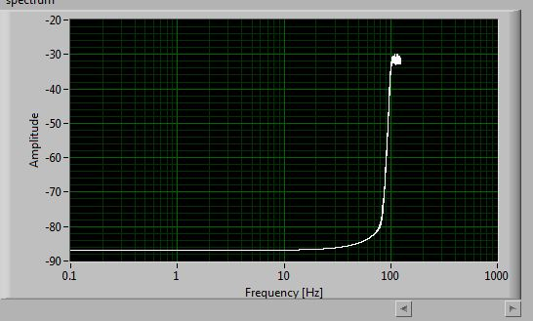
Filtered PMT Spectrum

Slide 9
DAQ System
Preamp/Fiber Optic transmitter
250 Mhz A/D
Conv
PMT/APD
Virtex -5 FPGA
12 TB
750 MB/Sec
RAID
Pxie Bus
Streaming RAID
Controller
I Gbit/sec
100 Mbyte/sec
CPU
Virtex-5 FPGA has multiple
Parallell-pipline FFT cores
Real time data-Filtering/coorrelation?
GPS Clock
Pxie Backplane (4 Gbit/sec)

Slide 10
Pipelined Data Analysis
x²
Digital Filter
Tele 1
Auto-correlation
x*y
Digital Filter
Cross-correlation
Tele 2
y²
Auto-correlation
This may be the only way of keeping up with the large dataflow in real time…..

Slide 11
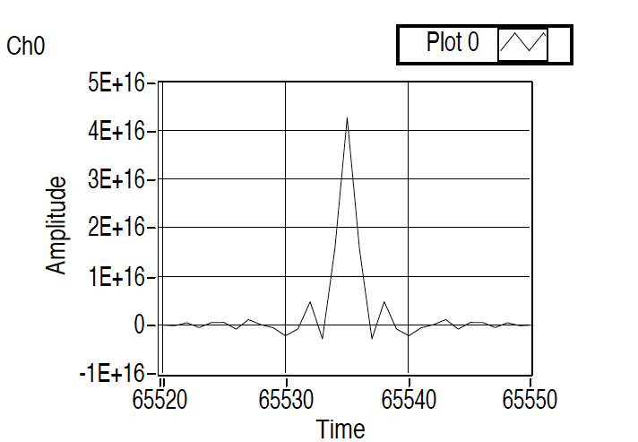
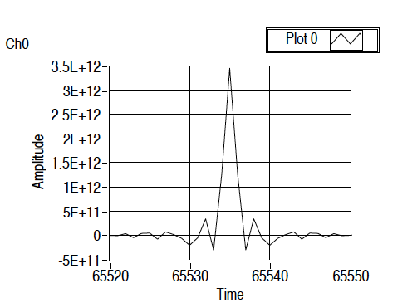
Digitizer/Software Correlation tests with PMTs/Preamps
Simulated Single PMT Measured Single PMT
AutoCorrelation AutoCorrelation

Slide 12
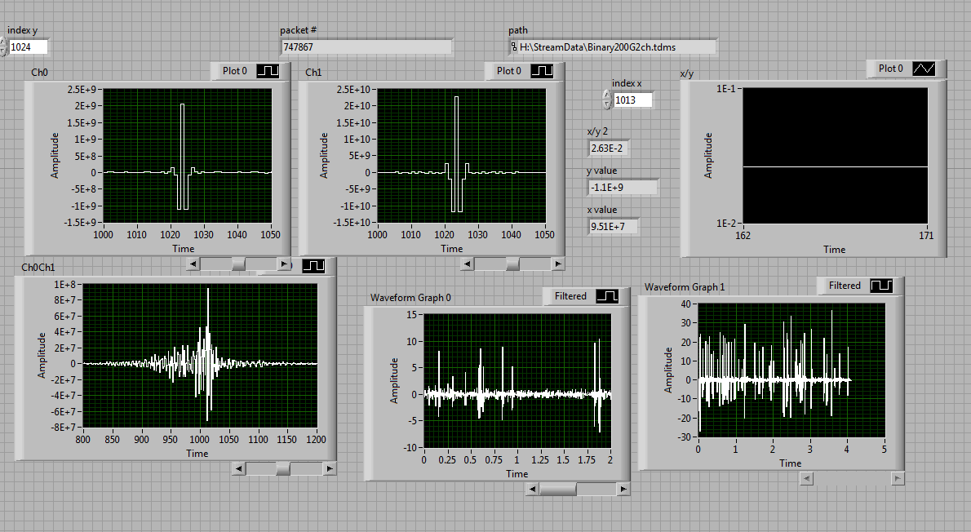
2 PMT Cross Correlation: Noise Pickup between adjacent PMTs
-Radio Crosstalk generated by RF noise from PMTs firing
-Encase in RF shielding/Use Fiber optics to sample light
4nsec

Slide 13
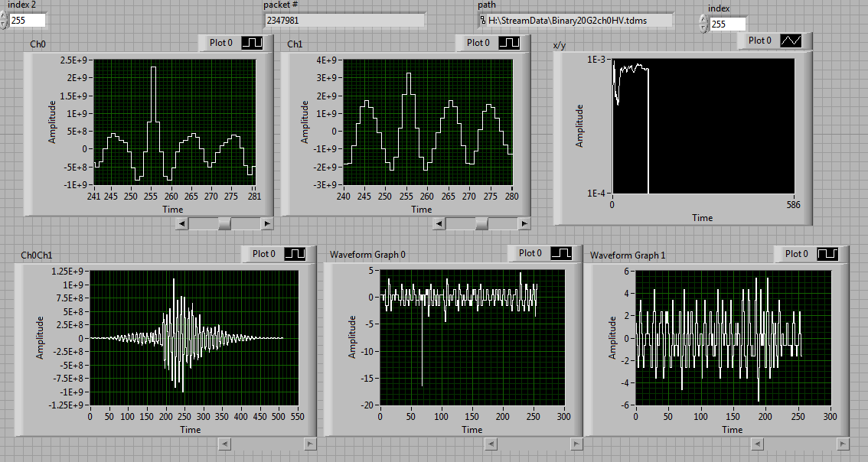
2 PMT Cross Correlation: Residual Correlation
-Cosmic ray secondary particles striking both PMTs
-Cosmic ray charged particles fluorescing in fiber optic cable

Slide 14
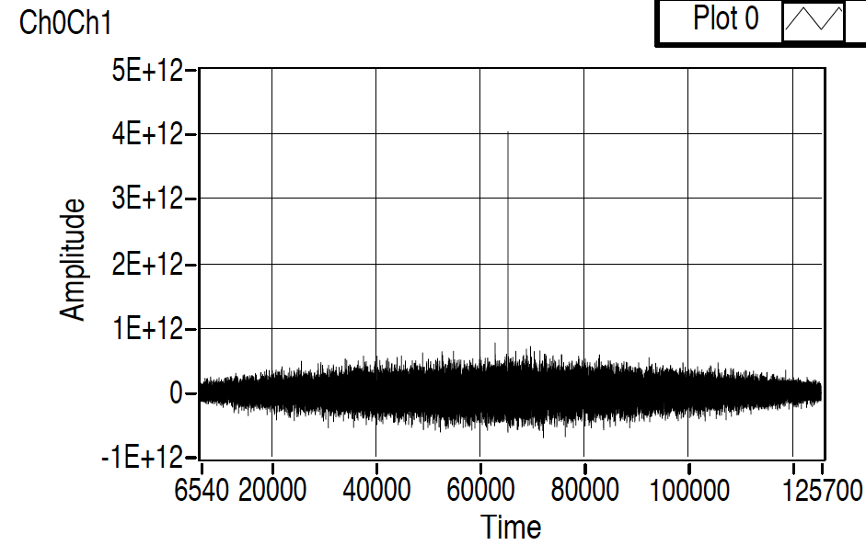
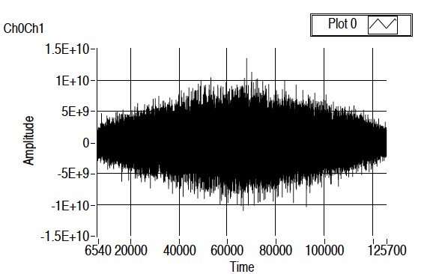
Digitizer/Software Correlation tests with PMTs/Preamps
Simulated 2-PMT Cross-correlation Measured PMT Cross-Correlation background
2G events seeded correlation = 1e-3 correlation noise < 1E-4
We should be able to measure correlation with excellent accuracy!

Slide 15
SII Lab Measurement/Hole diameters
(Laser/Rotating Disk)

Slide 16
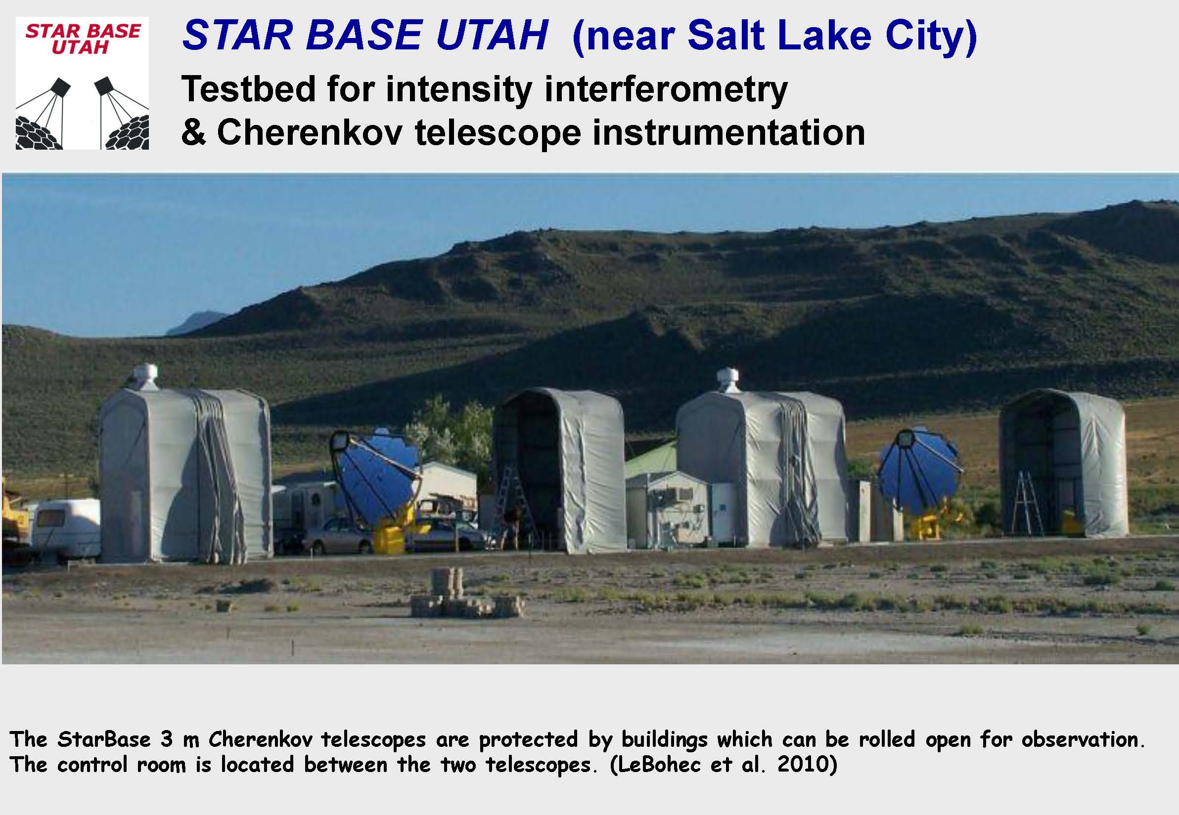

Slide 17
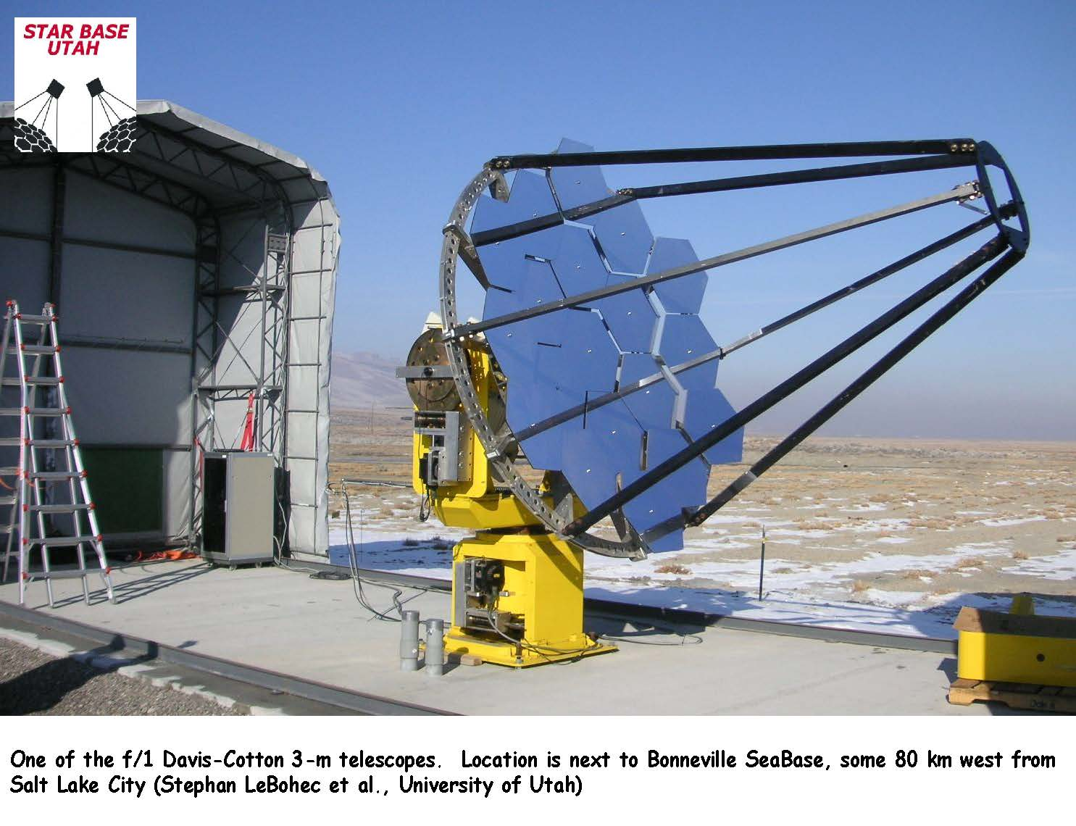

Slide 18
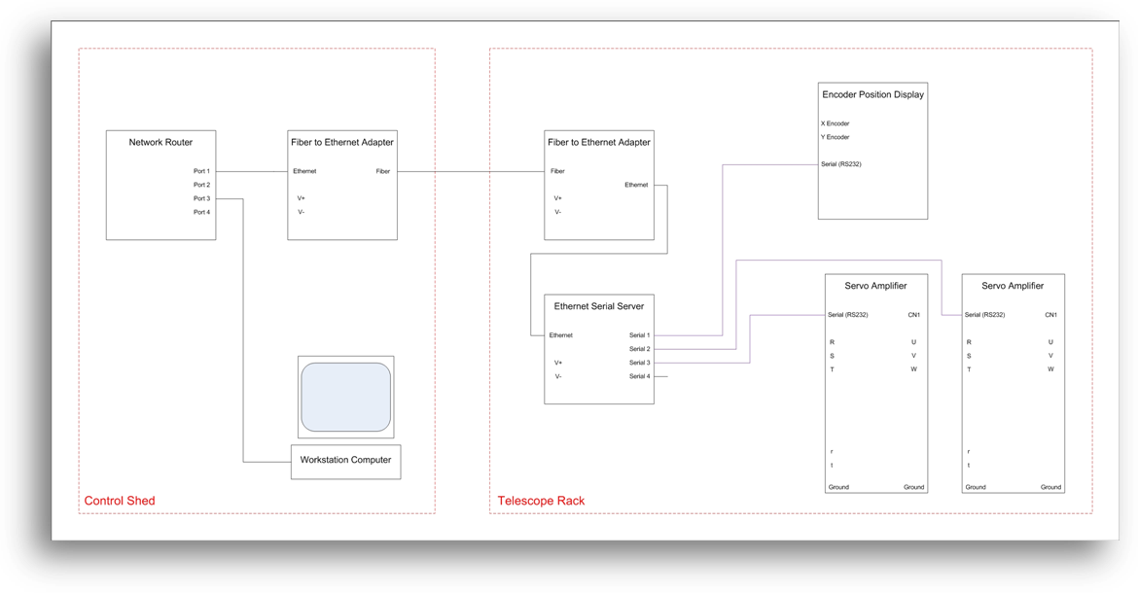
Telescope Tracking Control System:
LabView Based Servo System
Remnant of “Telescope Array 1999”

Slide 19
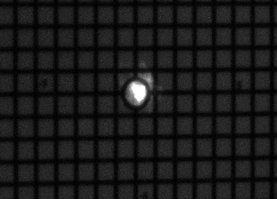
Observed tracking Performance: Alpha Lyrae Tracking
Error < 0.01°

Slide 20
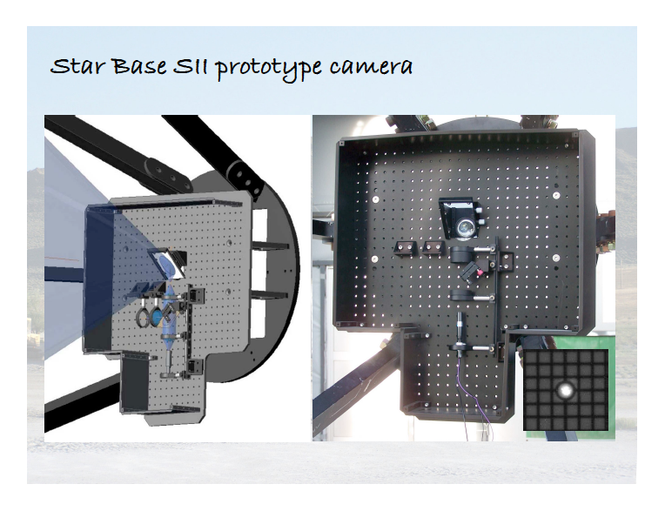

Slide 21
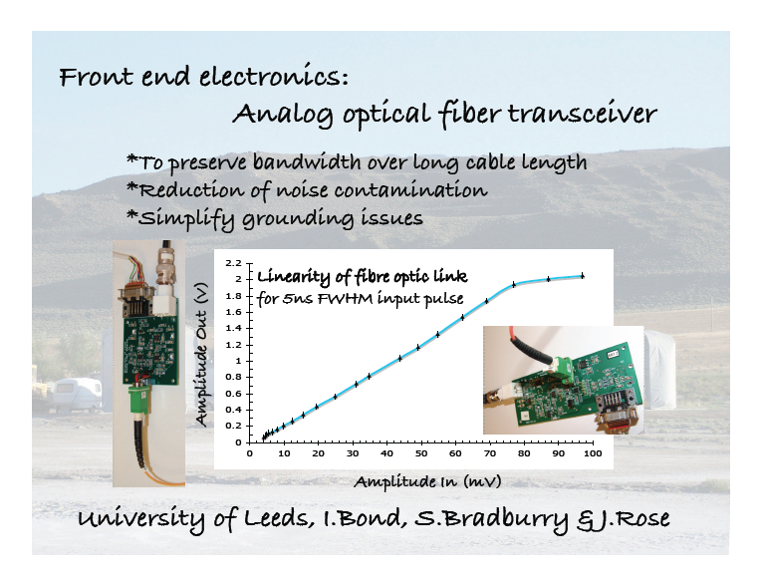

Slide 22
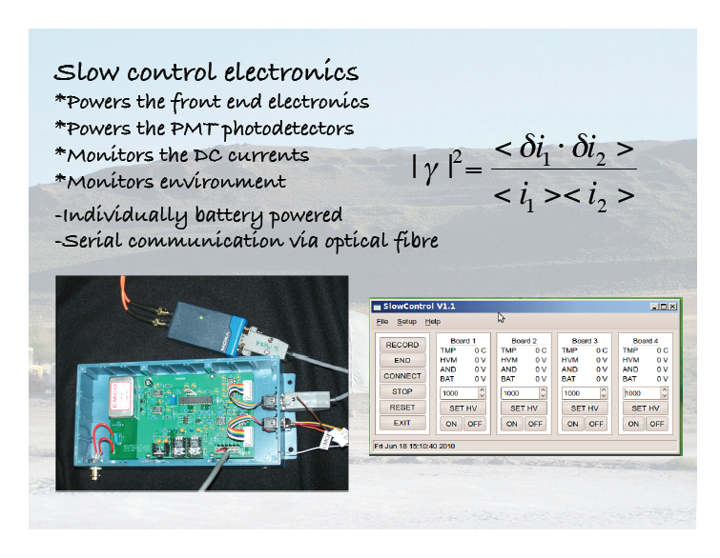

Slide 23
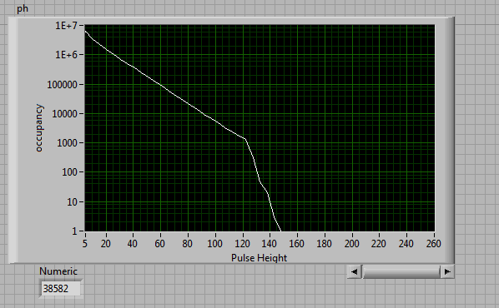
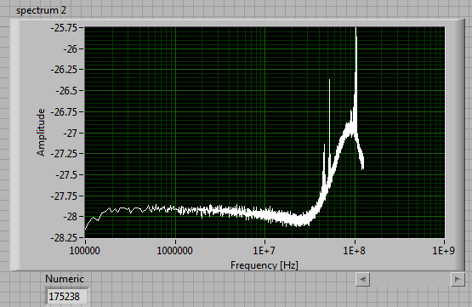
Star Observations (April 2014):
αLeo (Regulus): V = +1.35
ε Leo (Algenubi) V= +2.98
Single Telescope Observations
Study Telescope tracking
Night Sky Noise
Interference noise
Needs some further
investigation, pipelined
filtering?
Two Telescope Observations
In Summer 2014
Test SII & Pipelined RT analysis
NSB
VSCEL cutoff
Signal
??
VSCEL
Filter

Slide 24
Observation times with the StarBase telescopes
StarBase:
For T= 15 min ( V =1 )
T= 97 min (V = 2)
StarBase Baseline: 23m
Unresolved < 1 mas (400 nm)
Examples: α Leo, β Tau or η Uma

Slide 25
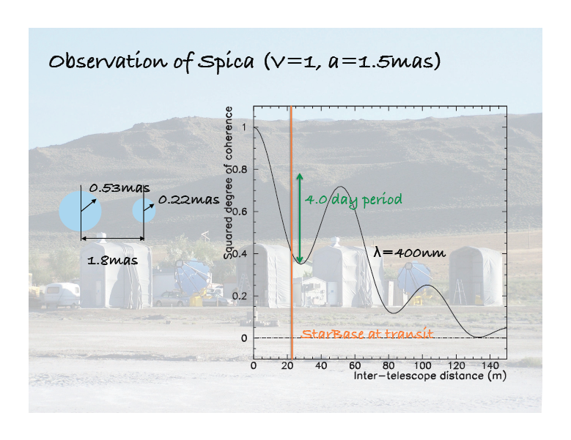

Slide 26
Future
Testing at StarBase Summer 2014: 2-telescope correlations
Testing at VERITAS (late 2014?)
CTA observatory
  Need to write Science Requirements, Level A/B requirements
  Technical Design review period ending (30 days)
  After TDR design gets frozen: Difficult to add after!
  High priority: Need to form working group!

Slide 27
CTA Design Questions
Photo-detectors (SST, MST, LST, SCT)
Telescope-to-Telescope digitization synchronization (< 2 nsec)
Digitization/Storage requirements
Data processing requirements
  Real Time Monitoring
  Higher order correlations

