Slide 1
SPICA: a new visible combiner for CHARA
Signed by many colleagues!

Slide 2
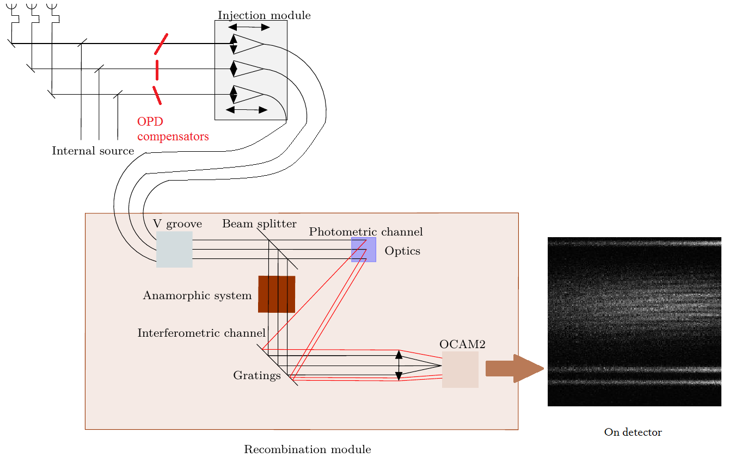
Summary of the previous seasons
2012: VEGA limitations (intensified CCD+multispeckle) + Prospect on CHARA/AO + Progresses on EMCCD ➔ propositions P. Bério (FRIEND)
2013-2015: FRIEND development and tests
2015: first discussion at Atlanta
2016: Visible meeting after the CHARA Meeting
2016-2017: Definition of the SPICA proposal, funding request (5-year grant unsuccessful but local funding ok to start), project organization.

Slide 3
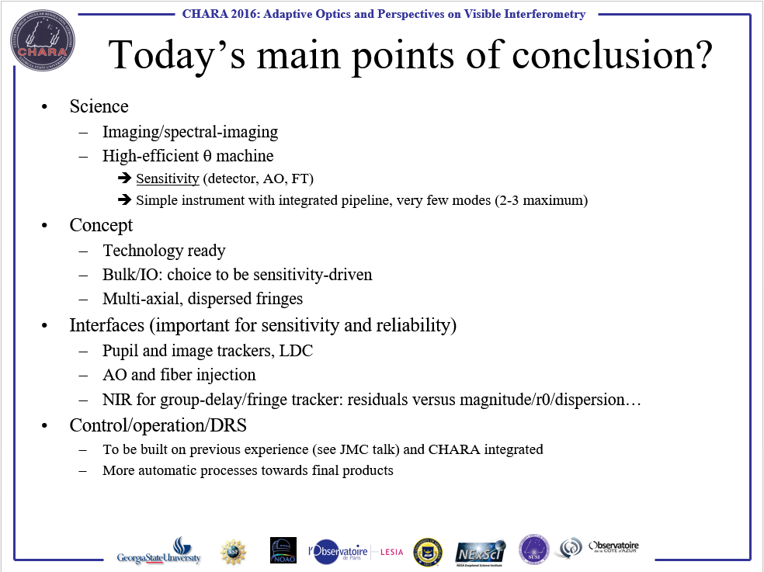
Conclusions of Visible day (Nice, 2016)

Slide 4

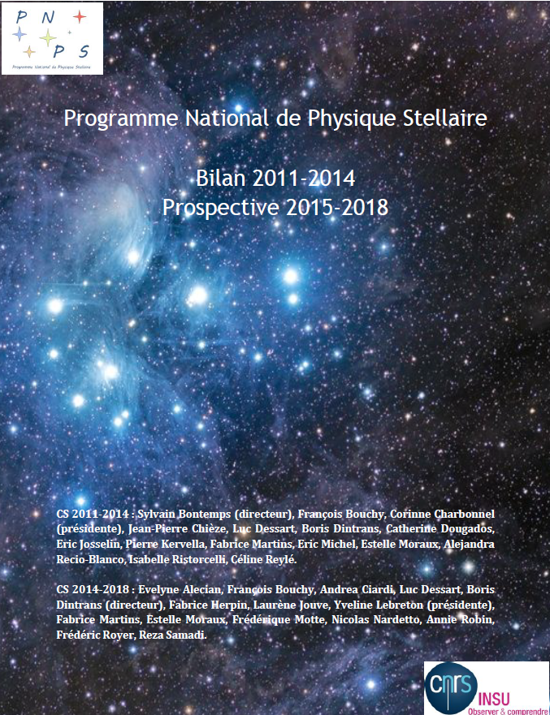
Stellar Parameters and Images with a Cophased Array
if we don’t know the star, we don’t know the planets
Exo earth
Characterization
Direct imaging
From planets to planetary systems
Planet and environment
Multiscale approach
Diversity
Formation & evolution
Stars as Sun
Star/planet
Asteroseismology
Surface imaging
Improved modeling
Habitability
Diversity
High angular resolution

Slide 5
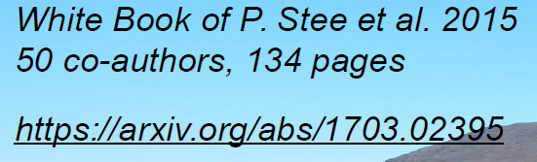
SPICA science case
Surface-brightness-color relations
Masses
Fundamental parameters as a function of SpTy
  Radius
  Effective Temperature
  Limb darkening
        FROM EMPIRICAL MODELS TO MEASURES
Exoplanets host stars
Asteroseismic targets
Original and unique support to a large panel of space missions (Gaia, TESS, CHEOPS, PLATO) and unique support for stellar masses and stellar evolutionary constraints

Slide 6
3 years * 70 nights = 1000 stars
1000 stars: 100* for spectral imaging, 200* binaries or multiple, 700* for FP
  5*100+10*200+2*700=3900 observations + calibrators ➔ 8000 data points
  40 objects per night
2015: 187n, 4699obj ➔16obj/n. Factor 2.5 missing
But
  AO ➔75% of ‘good seeing’ conditions
  6T means 15V²
  Low spectral resolution, improved number of channels, λ-coverage
Probably feasible:
  PAVO/FLUOR experience of fast shift
  Queue scheduling and optimization

Slide 7
SPICA: a first synthesis
  High-efficient θ/FP machine
    Sensitivity (detector, AO, FT), Efficiency (6T)
    Simple instrument with integrated pipeline
    R=100, 600-900nm
  Imaging/spectral-imaging
    R=3000 to preserve a good sensitivity
    6T
  R>30000 option for specific studies
A: a classical dispersed fringes (VEGA/MIRC/VISION) 6T
B: a more prospective HR, wide band design with Echelle Spectrograph 3-6T
C: a powerful Phase Tracker

Slide 8
Main points of attention
Sensitivity
  AO-Fiber coupling and V² optimization
  Alignment control (pupil and image)
  Simple design; choice of components, lab implementation
  Bulk/IO choice
  Exposure time: Group Delay – Phase tracking
Efficiency
  Fight against downtime and overheads
  Instrument-Array interface optimization
  Automatic execution of OB + optimized night scheduling ➔ f(α,δ)
  ‘integrated’ pipeline

Slide 9
Two main drivers for performance
Detector
Nüvü512 ok for Mode A, 6T, low noise, fast readout
Nüvü1024 ok for Mode B, 3T, ~20 orders, R=30000 & Δλ=200nm + Phase Tracker #1
IR detector for Phase Tracker
(Selex?)
Phase Tracker
Group Delay is mandatory
Phase Tracker #1: DIT=200ms, λ/10 (60nm)
Phase Tracker #2: DIT=30s, λ/4 (150nm)
➔Gravity like FT
➔ IR versus Visible
A: LR/MR with Group Delay
B: HR
C: Phase Tracker
Notes:
K=7, 100nm Gravity

Slide 10
Expected performance (1)
Based on VEGA/CHARA + FRIEND experience
S/N (V²) equation comes from Gordon&Busher 2012 (eq.28)
Numerical hypothesis
  Tinst=0.01; T-AO=0.8; SR=0.25; Coupling=0.2 ; Vinst=0.9
  QE=0.9, RON=0.1, Ndark=0.0002 (NUVU)

Slide 11
Expected performance (2)
Limiting magnitude defined as S/N=10 per spectral channel in 10mn of integration
 | R=100 | R=3000
V²=0.25 | 8.7 | 5.0
V²=0.01 | 5.6 | 1.9
Table 1: Limiting magnitude with a group delay tracker only
 | R=100 | R=3000
V²=0.25, DIT=0.2s | 10.1 | 6.4
V²=0.25, DIT=30s | 11.4 | 7.7
V²=0.01, DIT=0.2s | 6.7 | 3.0
V²=0.01, DIT=30s | 8.0 | 4.3
Table 2: Limiting magnitude with a phase tracker
These estimations use the same S/N calculator of FRIEND, validated on-sky
Notes:
In large band R=10 means lc=6µm which mean Group Delay with typically lc/20=lambda/2…. Hard!

Slide 12
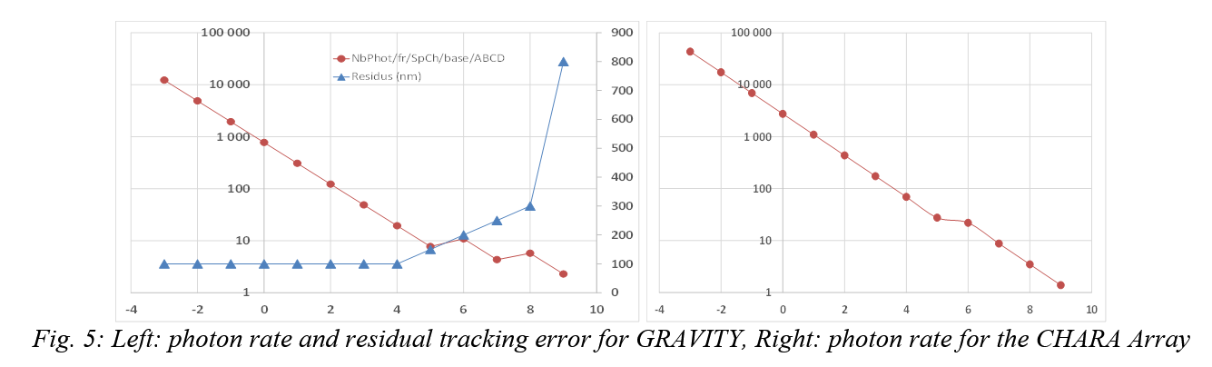
Estimation of performance for a H-band CHARA FT
H band FT, 5 SpCh, 6T multiaxial, Selex detector. T0=10ms , Texp=5/10ms
VLTI-GRAVITY FT performance
Adaptation of MIRC? New system? TBD…
Notes:
The differences are: H band versus K band, the CHARA Array Transmission in H = 10% versus VLTI_AT transmission in K = 29%, coupling efficiency of 65% instead of 10% at the present time on the VLTI/AT (NAOMI AO systems not yet in operation), Exposure time of 5ms below H=6 instead of 0.85ms below K=6 and 10ms above H=6 versus 3ms between K=6-8 and 10ms above K=8. The difference in exposure time is reasonable thanks to the difference of coherence time between Mount Wilson (10ms) and Paranal (3.3ms). We use a reduced Fringe Tracking transmission from 20% to 12% to account for the 4T to 6T evolution.

Slide 13
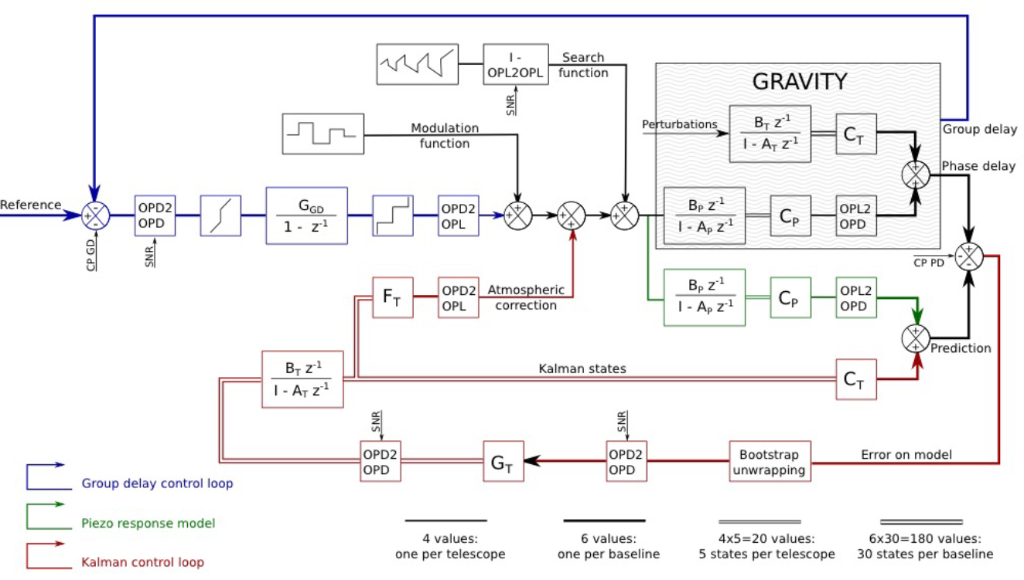
GRAVITY State machine. © S. Lacour

Slide 14
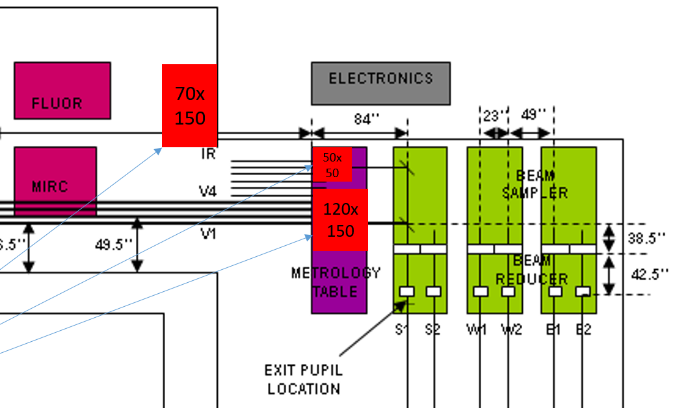
Instrumental principle of SPICA
2D
6D
5D
Pickup optics: principle of PAVO dichroics
Parabola + fibers + Birefringence
Retro-feed of fibers for alignment (Pup+Im)
Extraction of photometry
Access to CHARA sources for daytime alignment
FRIEND-like
4D
3D
Combiner+Detectors
Infrared injection?
Visible injection

Slide 15
Work breakdown (1)
Pre-studies on critical components
  Nuvu qualification + software control
  Evaluation of new actuators
  LDC check : do we need them? new glass for improved transmission?
Studies on critical conceptual aspects
  FRIEND fibers + OA injection : additional tip/tilt? Retro-lightening and direct co-alignment with CHARA?
  Principles for photometry extraction: pupil slicers, flux slicers, see possibilities after the fiber exit.
  Monitoring of seeing parameters : r0, t0

Slide 16
Work Breakdown (2)
Science requirements and performance evaluation
  FRIEND S/N values + all FRIEND parameters : SPICA S/N calculations and performance evaluation
  Decision on spectral resolutions
  Definition of observing modes
  SPICA large program science group organization
Fringe-tracking
  Design of a H-band fringe tracker optimized in terms of transmission, number of spectral channels, detector and all parameters.
  Continuation of performance evaluation

Slide 17
Work Breakdown (3)
Optical and mechanical implantation
  Pupils position, OPD scheme
  Optical design and implementation
  List of optical pieces, list of mechanical pieces, list of motors and actuators
  How to accommodate a high spectral resolution mode: number of beams, 2nd detector
  Alignment procedure, operating procedure
Software architecture :
  ICS FTS DCS OS
  Data flow of acquisition and archiving : database L0
  Data flow of DRS and RT-DRS : policy for L1 and L2
  Specifications of RT-DRS
  Specifications of quality check, database of quality check
  Automatic pipeline
  Operation software : queue observations, calibrator sequence

Slide 18
Short term activities
Continue to acquire experience with FRIEND prototype (especially AO/injection and piston)
Nuvu512 qualification/acquisition
System analysis ➔ specifications.
Implementation in the lab, general design of science light path and control systems
Funding mid-2017 ? ➔ 1st light mid-2019 (A), 2020 (B+C)

