Slide 1
VEGA: Status and future plans

Slide 2
2011 observations
60 nights scheduled, 48 with data
  2 runs (june=10n, october=11n)
  39 nights in remote (july, august, september, november, december)
~300 calibrated measurements, ~6-7 per night. 2To.
~10-15 programs in //.
Almost no technical activities on VEGA in 2011:
  Improvements of network reliability in Nice
  Ghost removal in the red camera
  Data processing improvement
  Installation of vegadrs-mwi (thanks Nils & Theo)

Slide 3
2011 science activities
Science (vegaobs@oca.eu): 30 persons
  15 OCA/Lagrange with 3 engineers (20-30%)
  5 in other labs in France (Grenoble, Lyon mainly)
  10 international collaborators: CHARA, Univ. Michigan, Denver, Univ. Praha, MPIA Heidelberg, Univ. Tunis, Téhéran, Leuven
Data reduction (vega-drs@oca.eu): 6-8 persons
  Improvements of post-processing tools
  Systematic error related to calibrator’s diameter uncertainty
  Better estimate of statistical errors
Funding of VEGA in 2012
  CNRS=7.9k€, OCA=11k€
  Special funding of Lagrange laboratory ~ 25k€ (detector)
  Grenoble and Lyon Observatory funding (CNRS and University) ~5k€
  Request for ANR funding (400k€/4 years): 2 post-docs position, 1 software engineer.
    “100 étoiles”: exoplanet host stars, asteroseismology, close stars… 3D hydro + transfer modeling

Slide 4
VEGA management

Slide 5
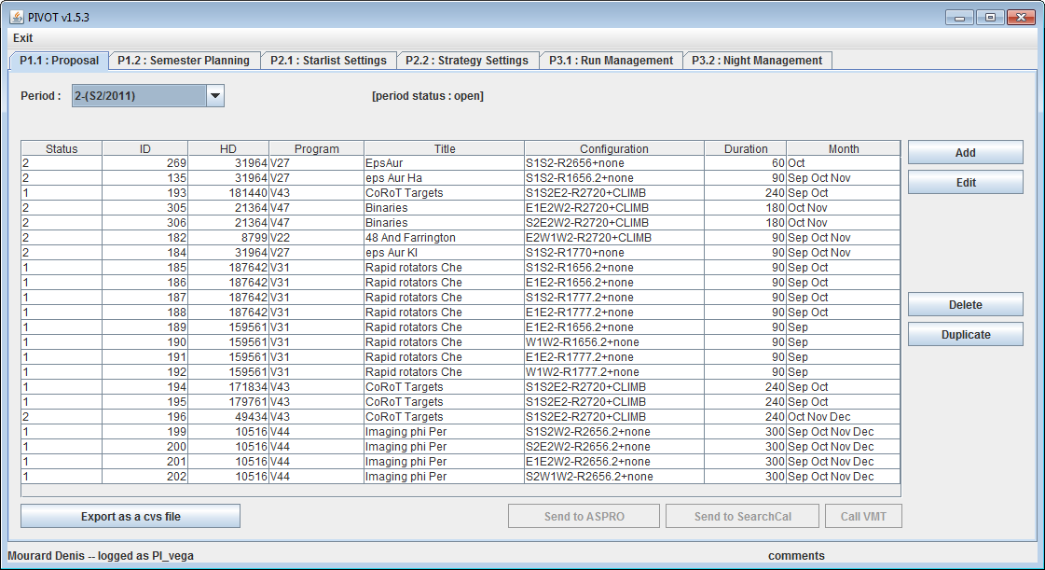
PIVOT interface
JAVA Webservice+Data base linked with ASPRO2 (JMMC)

Slide 6
2011 publications
http://www-n.oca.eu/vega/en/publications/index.htm
"An investigation of the close environment of β Cep with the VEGA/CHARA interometer", Nardetto, Mourard, Tallon-Bosc et al., A&A 525 (A67) (2011)
"The fundamental parameters of the roAp star γ Equ", Perraut, Brandao, Mourard et al. , A&A 526 (A87) (2011)
"Kinematics and geometrical study of the Be stars 48 Per and ψ Per with the VEGA/CHARA interferometer", Delaa, Stee, Meilland et al., A&A 529 (A87) (2011)
"Spatio-spectral encoding of fringes in optical long-baseline interferometry. Example of the 3T and 4T recombining mode of VEGA/CHARA", Mourard, Bério, Perraut et al., A&A 531, A110 (2011)
"A large Hα line forming region for the massive interactive binaries β Lyrae and υ Sagitarii", Bonneau, Chesneau, Mourard et al., A&A 532, A148 (2011)
"The binary Be star δ Sco at high spectral and spatial resolution. I Orbital elements, disk geometry and kinematics before the 2011 periastron", Meilland, Delaa, Stee et al., A&A 532, A80 (2011)
"The diameter of the CoRoT target HD49933. Matching the hydrodynamical limb darkening, asteroseismology and the VEGA/CHARA interferometric data", Bigot, Mourard, Thévenin et al., A&A 534, L3 (2011)
"Chromosphere of K giant stars: geometrical extent and spatial structure detection", Bério, Merle, Thévenin et al., A&A 535, A59 (2011)

Slide 7
Works in progress
γ Cas I & II (Smith et al., Stee et al.)
MWC361: almost ready: discussion on accretion at periastron. Benisty et al.
ε Aur: almost ready for submission, Mourard et al.
α Cephei: rotation. paper almost ready, Delaa et al.
θ Cyg + others host stars (see Ligi)
HR7349: CoRoT giant target, VEGA+CLIMB but more data is expected. Bigot et al.
AB Aur: paper on the model including VEGA data. Variability for long term purpose. Perraut et al.
λ Tau: eclipsing binary. Paper in preparation, Nardetto et al.
CoRoT targets: good data, interpretation in progress
P Cygni: draft existing including modeling (OC). CLIMB Brγ to come.
Phi Persei: MIRC6T+VEGA4T: april-may (John’s visit in Nice)

Slide 8
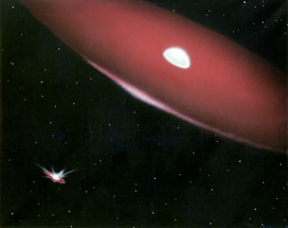
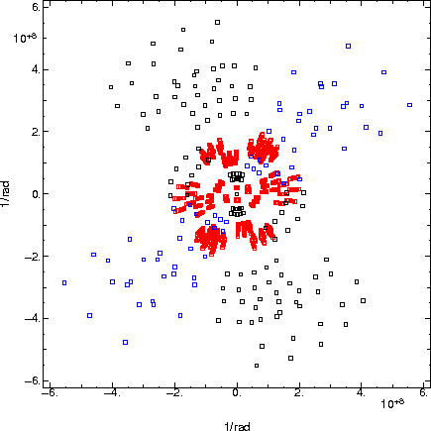
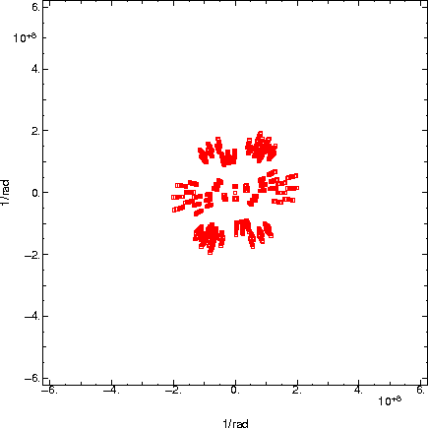
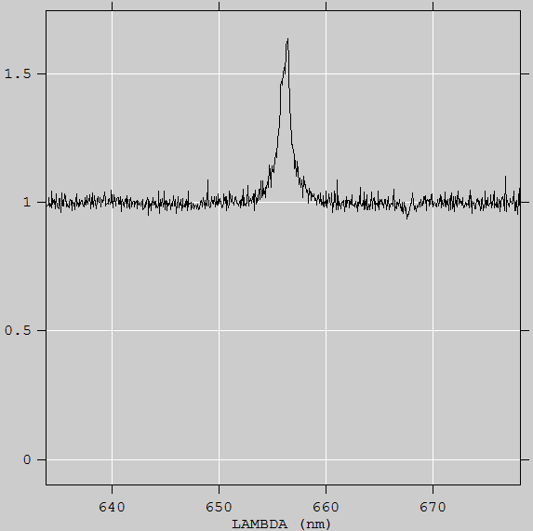
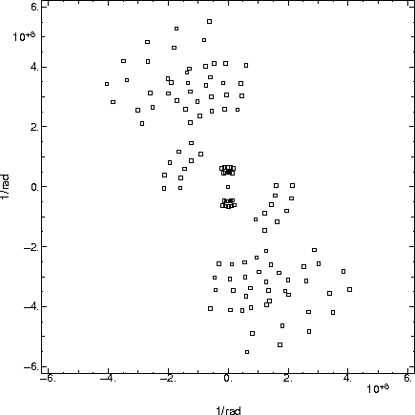
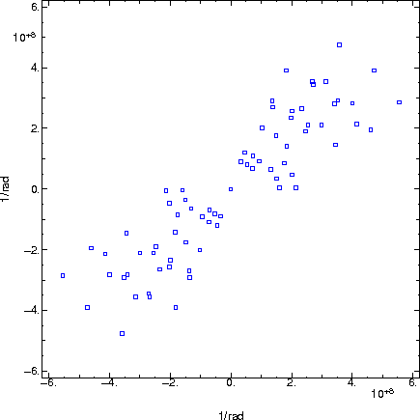
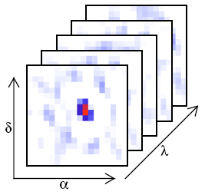
Perspectives of spectral imaging
October 18th and 19th on CHARA φ Persei
MIRC 6T @ 1.6µm, VEGA 4T @ 656-487nm
Hα, R=6000
Principle in Millour et al., A&A526, 2011
Notes:
Montrer la couverture (u,v) VEGA (bien montrer les canaux spectraux, disons de l’ordre de 10 en MR sur algolR pour rester raisonnable et voir si on dit au que l’on a aussi Hbeta…sachant qu’algolB reste rarement utilisable. Cela dit avec les r0 que l’on a eu je pense qu’on pourra tirer quelque chose de algolB donc autant le dire)
et MIRC (8 canaux sur la bande H)
Le must c’est 6T simultané mais insister sur le fait que 4T parmi 6 au cours de la même nuit c’est déjà un énorme progrès! Bien différencier les deux configs VEGA successives W1W1S1S2 et W1W2E1E2
Je sors le spectre Halpha et Hbeta de phi Per ainsi que Halpha de lam And (+ deux illustrations de la binaire phi Per avec son disque) et du disque de lam And tel que vu par MIRC actuellement.

Slide 9
Current known limitations
Photon counting detectors: saturation effects
  Locally on intense emission lines
  Globally on bright stars or 3T/4T modes
  Quantum efficiency
  Overheads (15ms of exposure every 25ms)
  Hard to work around 500nm (seeing effects)
Hard to get accurate measurements on low V²
SNR of closure phase measurements in photon counting regime.
Instrumental V²
  Difference between baselines
  Difference with time on a same baseline

Slide 10
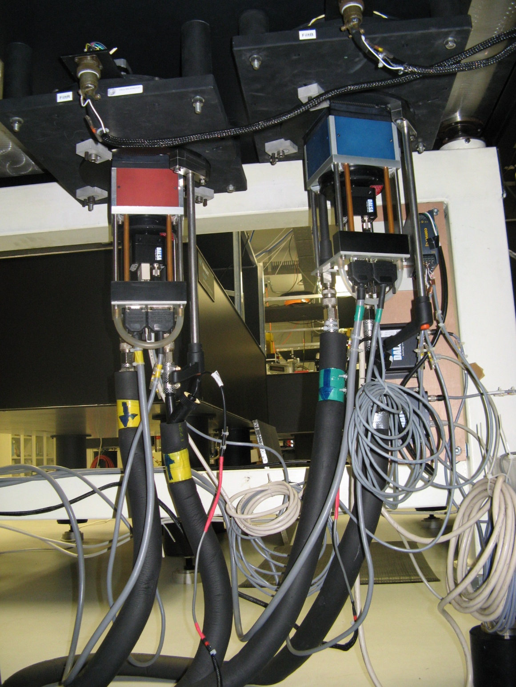
ALGOLR & ALGOLB
Photon counting detector
Upgrade of ALGOLB towards a modern
ALGOLR-2
EVOLUTION OF VEGA DETECTORS

Slide 11
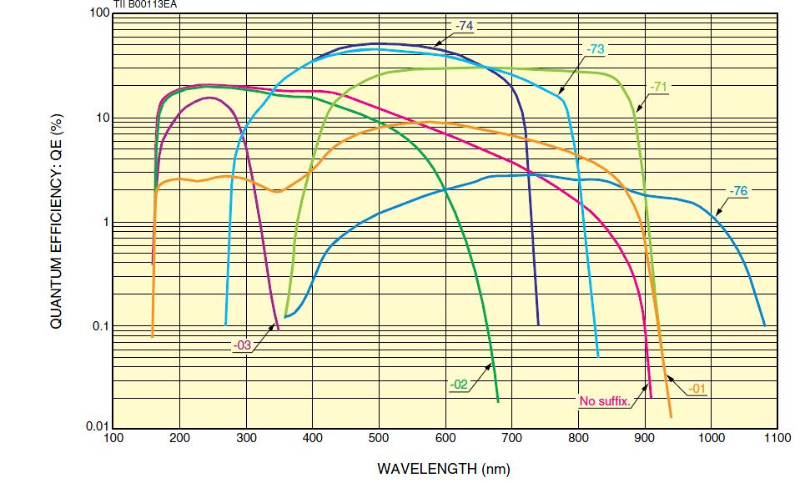
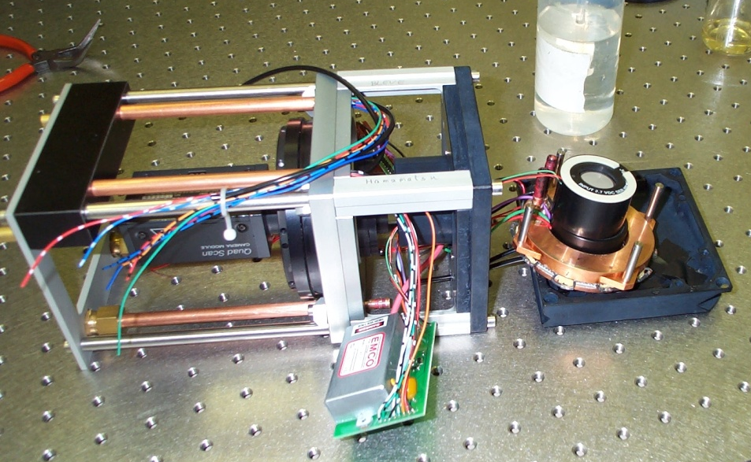
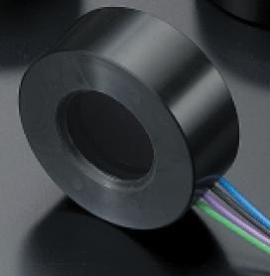
Intensifier modification
71 instead of 74

Slide 12
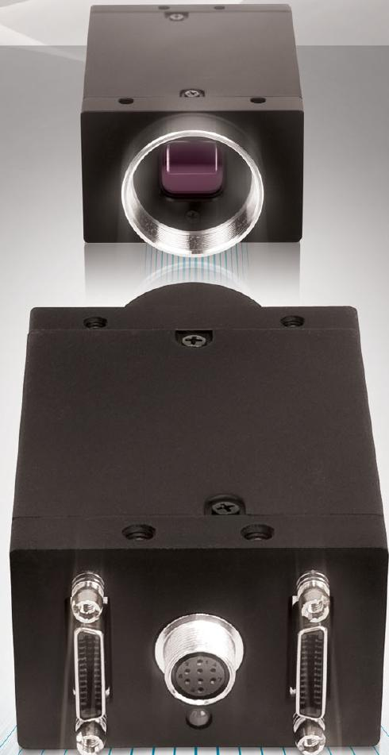
New camera
Point Grey Gazelle
Pixel 5.5 µm 2048x2048
Binning 2x2
150 Frames/sec
MROI (multiple Region Interest)
2 cameralink 10m cables
New computer
Windows Seven, 1 processor 6 cores
High speed disk 15K rpm
Frame Grabber Dalsa Xcelera PX4 Full
On board functions
Dark substract
Flat field correction
Integration will start in april. Tests in lab during summer, on the sky in october
Overhead: 40% → 0%, 5ms of exposure time (x3 in flux)

Slide 13
Evolution of VEGA in 2-3 years from now
Why thinking to a second generation of instrument?
  Installation of AO on CHARA telescopes
  Saturation in photon counting (high flux ou low D/r0)
  Measuring low V² is difficult
  Improving the limiting magnitude
  Improving accuracy of measurements
  6 beams combination
Analog detectors, low noise, high QE
Spatial filtering

Slide 14
Estimation of CHARA-AO performances
Expected in H
Estimation in visible (700nm)
  Strehl ≈30% for r0=12cm
  => coupling efficiency ≈25%
  Strehl ≈6% for r0=6cm
    => Coupling efficiency ≈5%

Slide 15
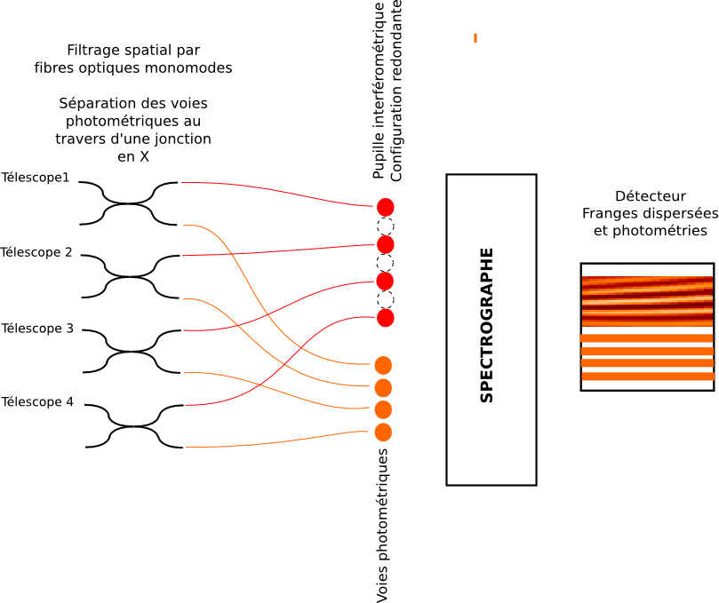
Principle of beam combination

Slide 16
Low noise detector
Commercial solution:
ORCA-flash4 de Hamamatsu, NEO sCMOS de Andor
  100 fps
  QE < 70%
  readout noise > 1.3 e⁻
  > 4Mpixels
OCAM2:
Fast and low noise detector (Grenoble&Marseille)
  1500 fps
  QE > 90% from 600nm to 800nm
  readout noise 0.13 e⁻
  240x240 pixels
Journée Interférométrie LAGRANGE, 3 Février 2012

Slide 17
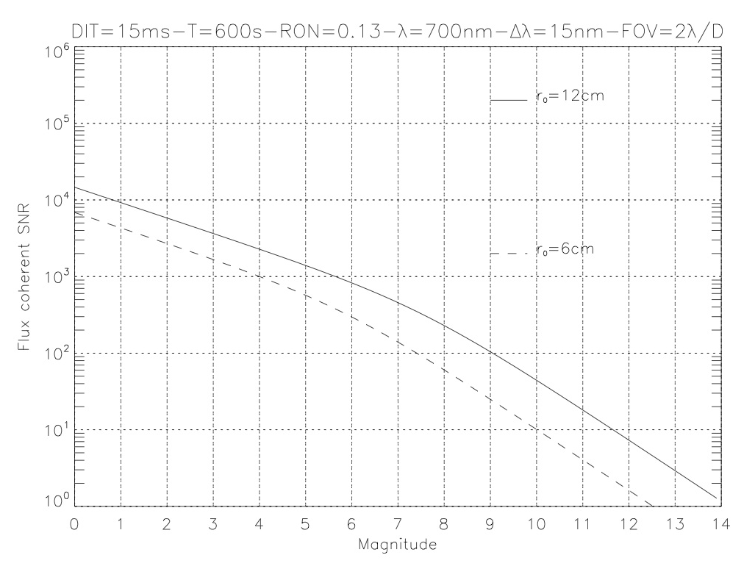
Expected Performances with OCAM2
Paramètres avec OCAM2:
  Efficacité quantique: 90%
  Transmission CHARA: 3%
  Transmission Spectro: 46%
  Transmission OA: 80%
  Transmission Polar: 50%
  Bruit de lecture: 0.13
  4 pixels par frange
  FOV: 2λ/D
  Δλ: 15nm @ 700nm
  n_{pix}: 48x214
  DIT: 15ms
  M: 40000 (10 minutes)
  V_{inst}: 0.7
  RatioPhot: 20%
V*=0.1
V*=1
=> Almost 4 magnitudes better than VEGA

Slide 18
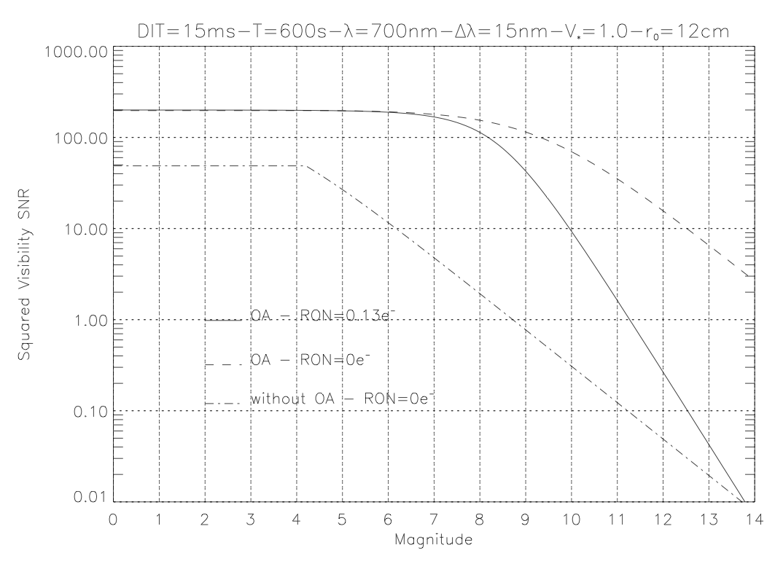
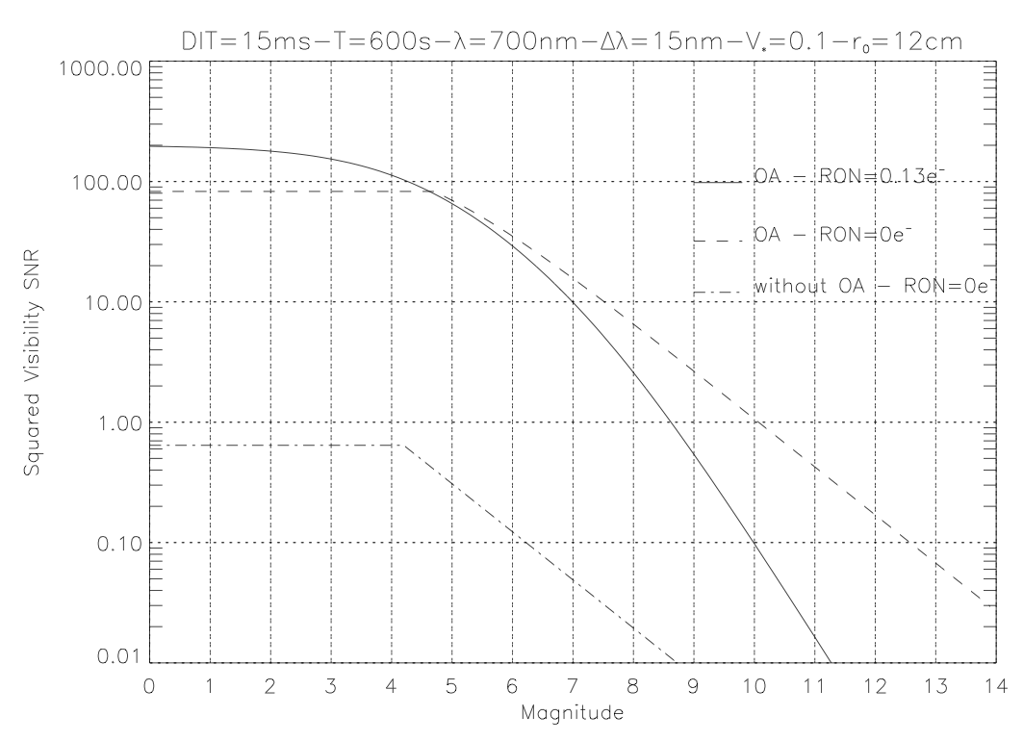
SNR of power spectrum Gordon&Buscher (2011)
  Cross terms between readout and photon noise
  SNR of fringe detection, not really for estimation of measurement errors
VEGA actuel
VEGA actuel
=> Photon counting detectors are still interesting at very low flux

Slide 19
Solution AO/OpticalFiber/OCAM2 seems very promising
=> theoretical limiting magnitude around 11
But:
  240 pixels maximum in the spectral direction
    reduction of spectral band or image of three different bands
  To cover 600-900, possibly 3 different optical fibers set…
Next steps:
  Improved simulations (AO simulator of Mike Ireland)
  Better performances estimation
  Tests of an OCAM2 detector on VEGA this year (october is foreseen)
  Definition of exact fiber sets
To be decided:
  Low noise for bright objects & Photon counting for faint objects
  Budget?
VEGAS (VEGA Second generation)
Berio, Clausse, Mourard et al.

Slide 20
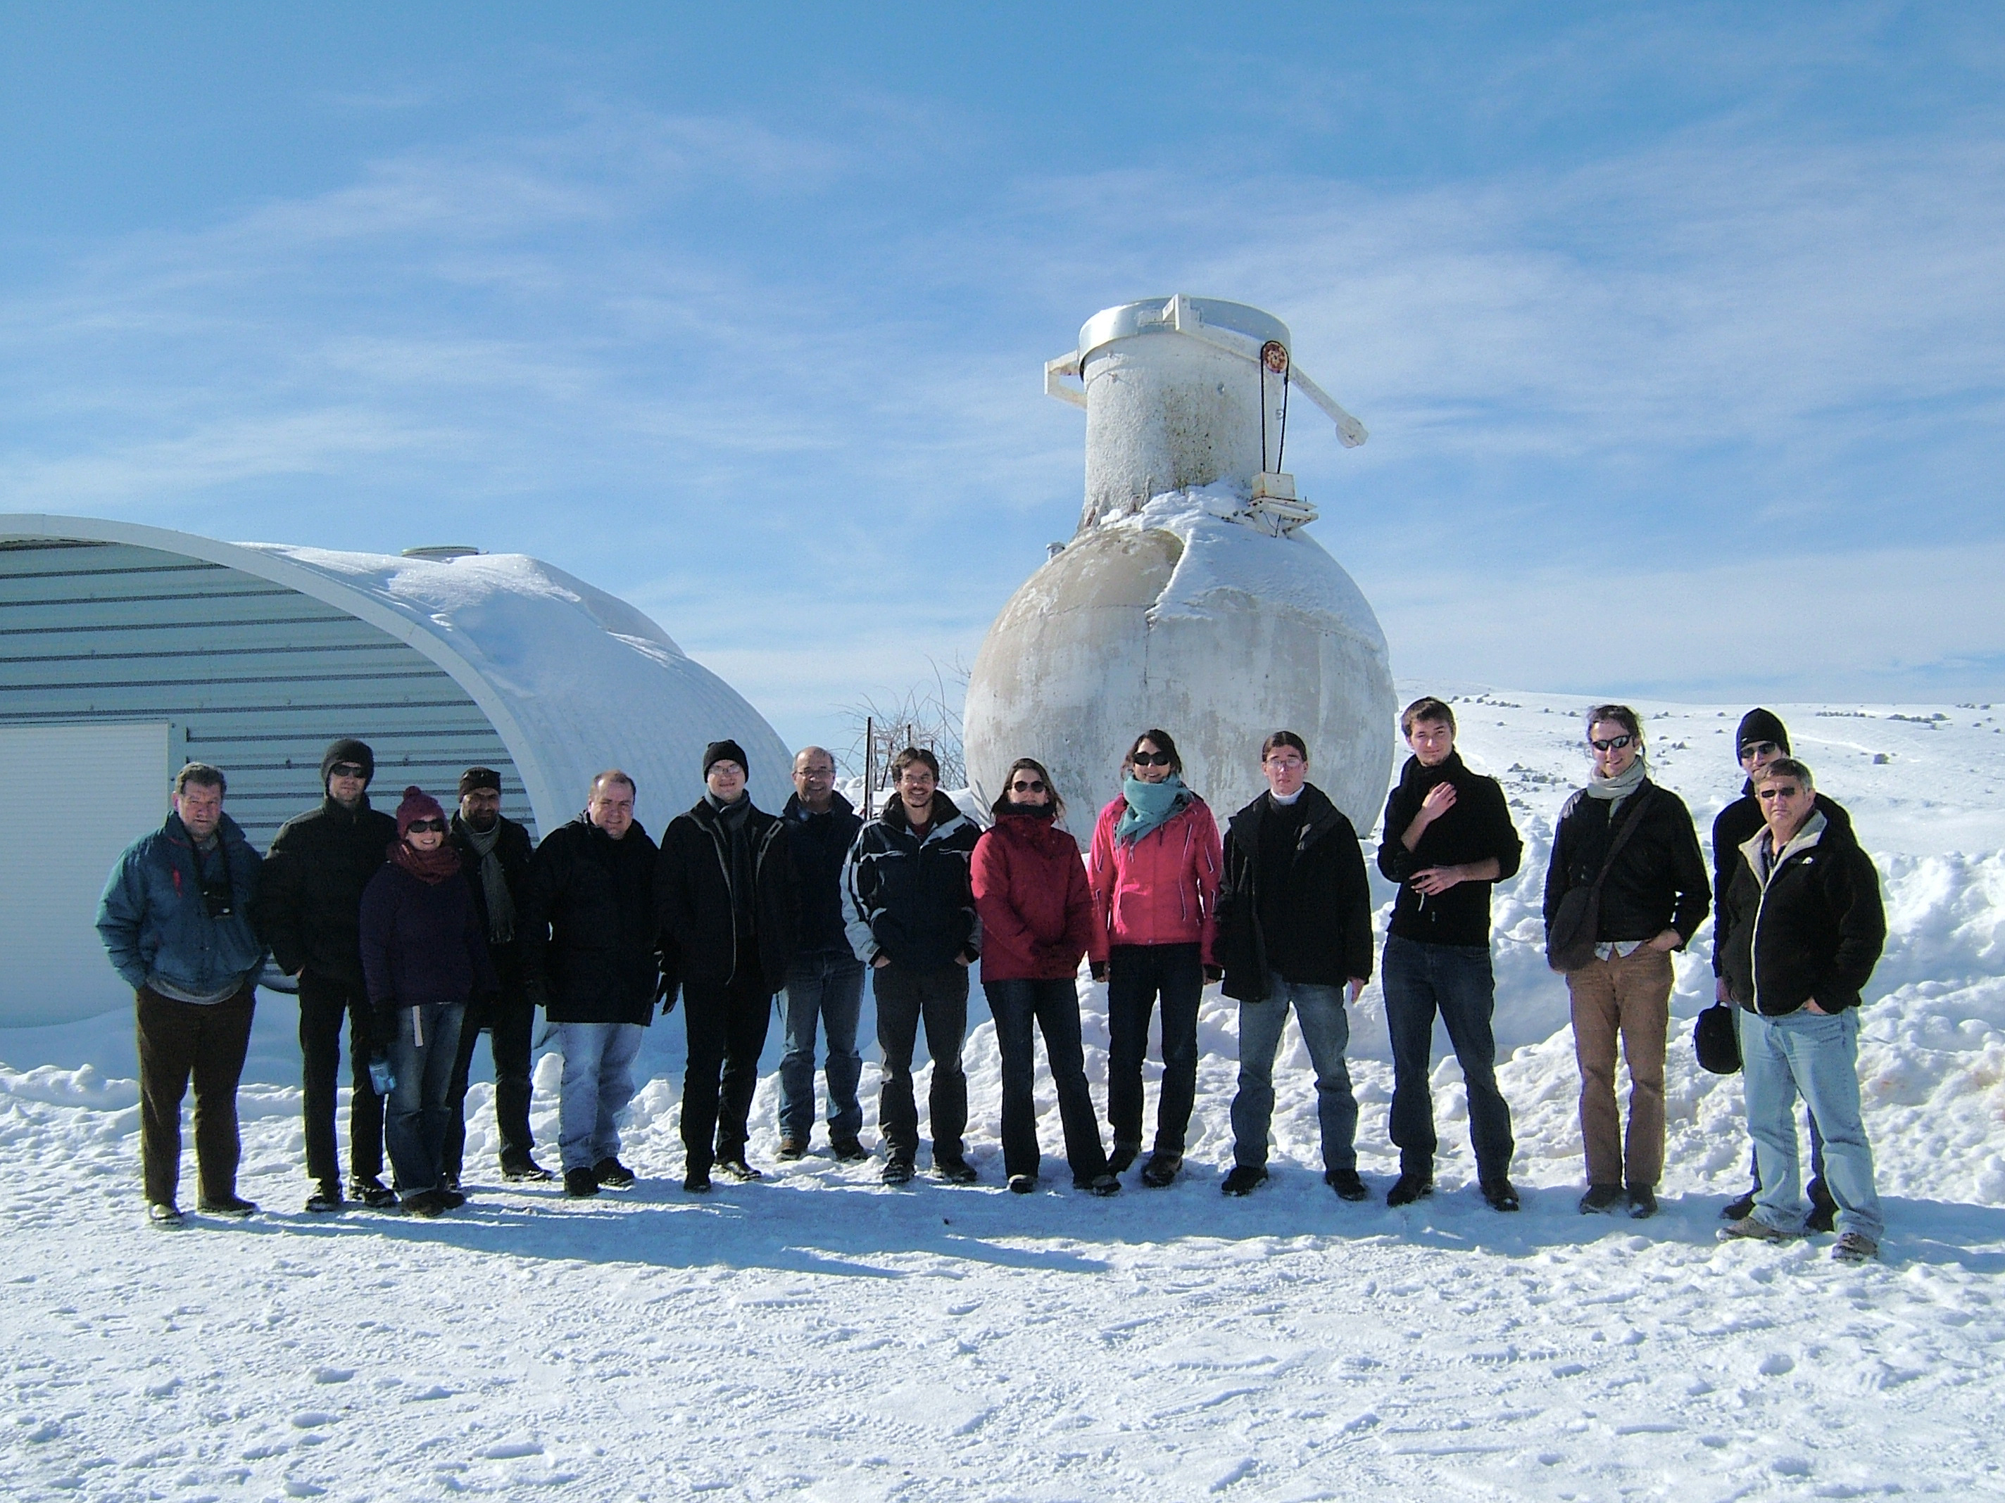
Thank you for your attention
Calern meeting, february 6th, 2012

