Slide 1
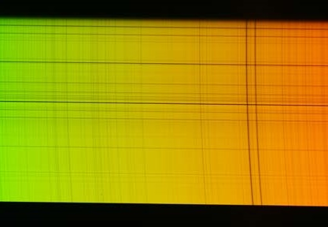


THE LHIRES-III
SPECTROGRAPH
Version 04, 14/11/2017
Jean-Pierre Rivet
CNRS, OCA,
Dept. Lagrange
jean-pierre.rivet@oca.eu
© C2PU, Observatoire de la Côte d’Azur,
Université de la Côte d’Azur

Slide 2
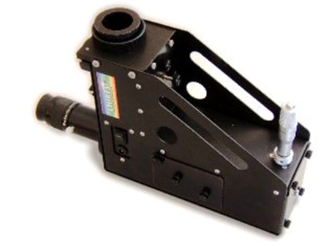
The LHIRES-III
The spectrograph
used at C2PU:
The LHIRES-III
Manufacturer:
Sheliak Instruments
http://www.shelyak.com/
LHIRES = Littrow High RESolution spectrograph

Slide 3
Contents
Basics about spectrographs
Basics about diffraction gratings
The LHIRES-III spectrograph
Practical issues
ESO reference spectra
Sample spectra

Slide 4
BASICS ABOUT
SPECTROGRAPHS

Slide 5
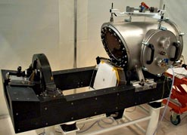
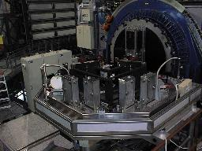
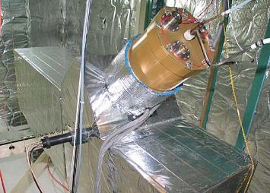
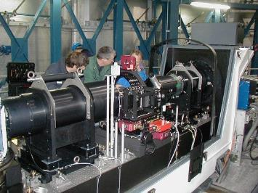
A wide variety of spectrographs
Slit spectrographs
Fiber(s) spectrographs
Echelle spectrographs
Integral Field Unit spectrographs
Fourier transform spectrographs
Objective prism spectrographs
...
SOPHIE spectrograph on
the 193cm telescope at OHP
UVES echelle spectrograph on
the UT2 telescope at VLT (ESO).
ELODIE spectrograph on
the 193cm telescope at OHP
GIRAFFE spectrograph on
the UT2 telescope at VLT (ESO).

Slide 6
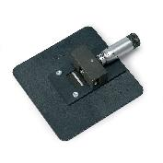
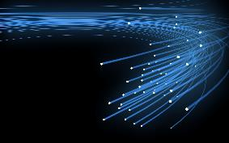
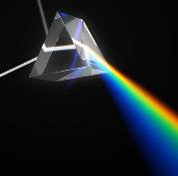
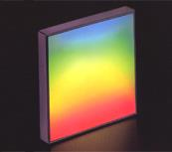
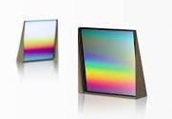
A wide variety of spectrographs
Several ways to select photons in the focal plane of the telescope:
Slit
Optical fibers
None
Several ways to do chromatic dispersion:
Prism(s)
Grating(s)
Grism (a combination of grating and prism)
...
Several spectral domains:
IR
Visible
UV
...
Several spectral resolutions:
Low resolution (for overall spectrum shape)
High resolution (for line profile sampling or radial velocities)

Slide 7
Building blocks
“Ordinary” slit spectrograph
The slit and slit environment:
located in the telescope’s focal plane,
selects the region of the field of view to analyze.
The collimation optics:
produces a image of the slit at infinity,
produces an image of the telescope’s pupil on the dispersive element.
The dispersing element:
introduces wavelength-dependent angular shifts.
The camera optics:
forms a sharp image of the slit on the sensor’s sensitive surface
The sensor (nowadays mostly CCD cameras):
records the spectral informations.
The calibration sources:
Tungsten filament bulb for flat-fielding (black body source),
spectral lamps (Th-Ar, Ne-Ar,...) for spectral calibration.

Slide 8
Building blocks
Collimation optics
Light from
the telescope
Collimated input beam
θ_{i}
Ne
Entrance slit
Calibration
sources
Camera optics
Sensor
θ_{r}
Dispersing element
(grating)
Dispersed beam

Slide 9
Littrow configuration
Littrow condition: θ_{r} = θ_{i}
Collimator optics = Camera optics
(cost effective configuration)
Side view
θ_{r}
θ_{i}
Top view

Slide 10
BASICS ABOUT
DIFFRACTION GRATINGS

Slide 11
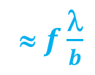
Diffraction by 1 element
Incident beam
assumed parallel
(wavelength λ)
Reflecting
element
Collimator
Screen
θ_{i}
≈ $f\frac{\text{λ}}{b}$
θ_{r}
f
b
Diffracted beam
Non-reflecting
substrate
Maximum in the direction of geometric optics: θ_{r} = - θ_{r}
Typical angular width: ~ λ / b

Slide 12
Diffraction by “n” elements
Reflecting
elements
Incident beam
(wavelength λ)
Collimator
θ_{i}
Screen
?
Non-reflecting
substrate

Slide 13
Diffraction by “n” elements
Incident beam
(wavelength λ)
λ
Collimator
θ_{i}
Screen
?

Slide 14
Diffraction by “n” elements
Diffracted beams out of phase :
destructive interferences
→ NO LIGHT
Collimator
Screen
NO LIGHT !

Slide 15
Diffraction by “n” elements
Diffracted beams in phase :
constructive interferences
→ MAXIMUM LIGHT
Collimator
Screen
LIGHT !

Slide 16
Diffraction by “n” elements
θ_{i}
Ray 0
Ray 1
Delay of Ray 1 wrt Ray 0 = a sin(θ_{i})
a
a
a
a

Slide 17
Diffraction by “n” elements
Delay of Ray 1′ wrt Ray 0′ = a sin(θ_{r})
θ_{r}
Ray 0′
Ray 1′
a
a
a
a

Slide 18
Diffraction by “n” elements
Total delay of Ray 1′ wrt Ray 0′ :
δ = a sin(θ_{i}) + a sin(θ_{r})
θ_{i}
Condition for
constructive interferences:
δ = k . λ
Ray 0
Ray 1
θ_{r}
Ray 0′
integer; called the “order”
Ray 1′
a
a
a
a

Slide 19
Diffraction by “n” elements
Order k = 0
Condition for
constructive interferences:
δ = 0, whatever λ
θ_{i}
Ray 0
Ray 1
θ_{r}
sin(θ_{i}) + sin(θ_{r}) = 0
Ray 0 ’
Snell’s law !
direction of reflection on the grating’s plane
according to geometric optics
NON DISPERSIVE
Ray 1 ’
a
a
a
a

Slide 20
Diffraction by “n” elements
Order k ≠ 0
Condition for
constructive interferences:
δ = k . λ
θ_{i}
Ray 0
Ray 1
θ_{r}
sin(θ_{i}) + sin(θ_{r}) = k . λ / a
Ray 0 ’
Ray 1 ’
DISPERSIVE
a
a
a
a

Slide 21


Focal pattern
Fraunhoffer’s diffraction
integral leads to:
with
Grating function
G(ξ)
Diffraction function
D(ξ)
θ_{i}
θ_{r}

Slide 22





Grating function
Grating function
G(ξ)
Diffraction function
D(ξ)
G(ξ)
N²
$$\frac{λ}{Na}$$
ξ
-2 $\frac{λ}{a}$
-1 $\frac{λ}{a}$
0
+1 $\frac{λ}{a}$
+2 $\frac{λ}{a}$
order -2
order -1
order 0
order +1
order +2

Slide 23




Diffraction function
Grating function
G(ξ)
Diffraction function
D(ξ)
D(ξ)
1
0.016
0.047
0.047
0.016
ξ
-2 $\frac{λ}{b}$
-1 $\frac{λ}{b}$
0
+1 $\frac{λ}{b}$
+2 $\frac{λ}{b}$

Slide 24
Diffraction pattern (monochr.)
N.a
b
Relative intensity
a
a
a
a
~ λ / (N.a)
Thickness of the
diffraction lines
Order
separation
N
~ λ / a
Diffraction envelope
Width of the
diffraction
envelope
~ λ / b
-3λ / a
-2λ / a
-λ / a
0
λ / a
2λ / a
3λ / a
sin(θ_{i}) + sin(θ_{r})

Slide 25
Scale correspondance
3 length scales for the grating:
Total width: N.a
Pitch: a
Diffractive elements width: b
3 length scales for diffracted pattern:
Thickness of the line: λ / N.a
Order separation: λ / a
Width of the diffraction envelope: λ / b

Slide 26
Diffraction pattern (polychr.)
Relative intensity
Order 0:
non dispersive
Order 1:
dispersive
Order 2:
more dispersive
Order 3:
even more dispersive
-3λ / a
-2λ / a
-λ / a
0
λ / a
2λ / a
3λ / a
sin(θ_{i}) + sin(θ_{r})

Slide 27
Blazed gratings
STANDARD GRATING
BLAZED GRATING
α (blaze angle)
θ_{i}
θ_{r}
θ_{r}
θ_{i}
: Normal to the grating surface
: Normal to the diffracting surfaces

Slide 28


Focal pattern
Fraunhoffer’s diffraction
integral leads to:
with
Grating function
G(ξ)
Diffraction function
D(ξ)
α
ϕ_{r}
ϕ_{i}
θ_{r}
θ_{i}
ϕ_{r}
ϕ_{i}
α (blaze angle)
: Normal to the grating surface
: Normal to the diffracting surfaces

Slide 29
Blazed vs standard gratings
STANDARD GRATING
BLAZED GRATING
Diffraction envelope is maximum when:
θ_{r} = - θ_{i}
Diffraction envelope is maximum when:
ϕ_{r} = - ϕ_{i}
( ϕ_{i} = θ_{i} - α , ϕ_{r} = θ_{r} - α )
0th order is maximum when:
θ_{r} = - θ_{i}
0th order is maximum when:
θ_{r} = - θ_{i}
α
θ_{i}
θ_{r}
θ_{r}
θ_{i}
ϕ_{r}
ϕ_{i}
α (blaze angle)
: Normal to the grating surface
: Normal to the diffracting surfaces

Slide 30
Diffraction pattern (polychr.)
STANDARD GRATING
Relative intensity
Order 0:
non dispersive
Order 1:
dispersive
Order 2:
more dispersive
Order 3:
even more dispersive
-3λ / a
-2λ / a
-λ / a
0
λ / a
2λ / a
3λ / a
sin(θ_{i}) + sin(θ_{r})

Slide 31
Diffraction pattern
BLAZED GRATING
Relative intensity
Maximum of
diffraction curve
on order k ≠ 0
Blaze angle α depends on
the central wavelength λ₀
and order k
-3λ / a
-2λ / a
-λ / a
0
λ / a
2λ / a
3λ / a
sin(θ_{i}) + sin(θ_{r})

Slide 32
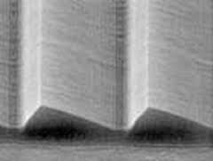
Real blazed gratings
“Real” gratings are
more like that:
Carved in a piece of glass by a very hard (diamond) tool with wanted profile and angle, driven by a machine with a high precision master screw translator, for highly regular groove spacing.

Slide 33
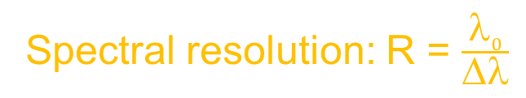
Spectral resolution
A single, infinitely sharp emission line...
... will lead to:
I(λ)
I(λ)
Convolution with
instrumental response
Δλ
λ₀
λ
λ₀
λ
Spectral resolution: R = $\frac{λ0}{Δλ}$

Slide 34
Spectral resolution
I(λ)
I(λ)
λ₁ - λ₀ < Δλ
Unresolved
Convolution with
instrumental response
Δλ
λ₀
λ₁
λ
λ₀
λ
I(λ)
I(λ)
λ₁ - λ₀ > Δλ
Resolved
Convolution with
instrumental response
Δλ
Δλ
λ₀
λ₁
λ
λ₀
λ
Spectral resolution = smallest visible wavelength span Δλ
divided by central wavelength λ₀

Slide 35
Spectral resolution
Instrumental response:
I(λ)
Δλ
λ₀
λ
= convolution of grating function with image of slit
Spectral resolution depends
on the grating and on the slit.
Can also be limited by CCD’s
pixel size...

Slide 36
THE LHIRES-III
SPECTROGRAPH

Slide 37
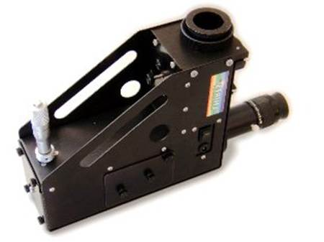
The LHIRES-III

Slide 38
The LHIRES-III
Micrometric screw
(to tilt the gating)
F/12.5 input beam
from the telescope
Guiding camera
Diffraction
blazed grating)
Bending mirror
Collimator / camera
optics
Focuser for the
guiding camera
Slit
environment
Science camera
Bending mirror

Slide 39
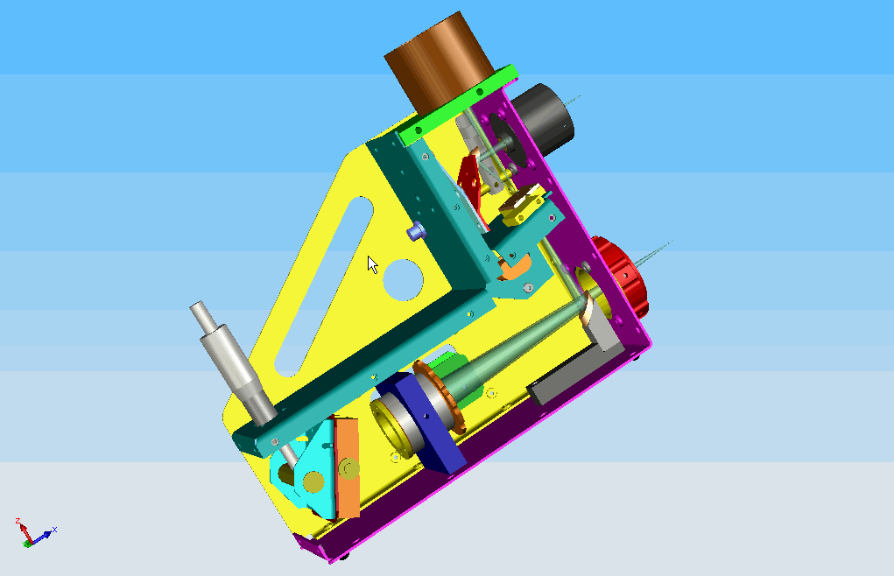
The LHIRES-III
F/12.5 input port
Guiding port
Bending mirror
Focuser for the
guiding camera
Slit
environment
Science port
Micrometric screw
(to tilt the gating)
Bending mirror
Diffraction
blazed grating)
Collimator / camera
optics

Slide 40
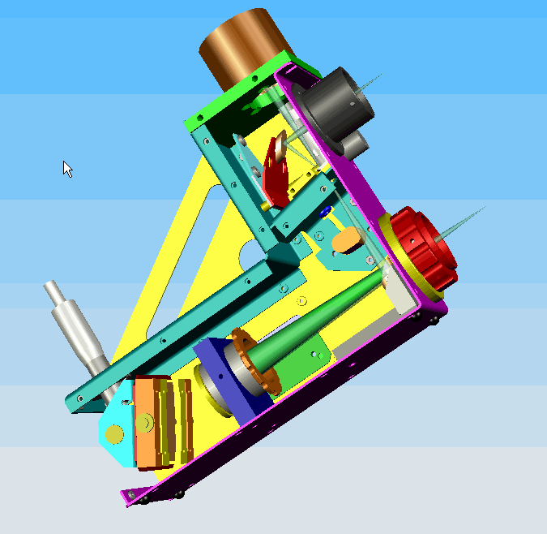
The LHIRES-III

Slide 41
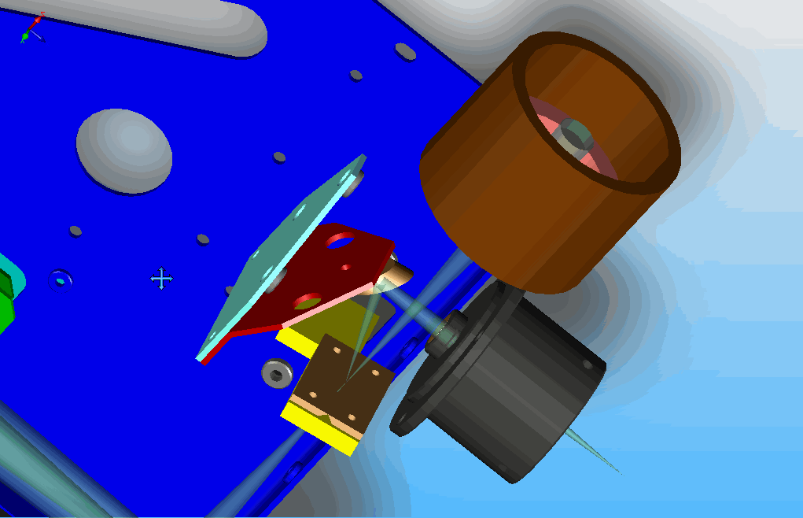
The slit environment
Bending flat mirror
Input beam
(from telescope)
Output port
focusing optics
Input slit
Guiding output port
Slit environment

Slide 42
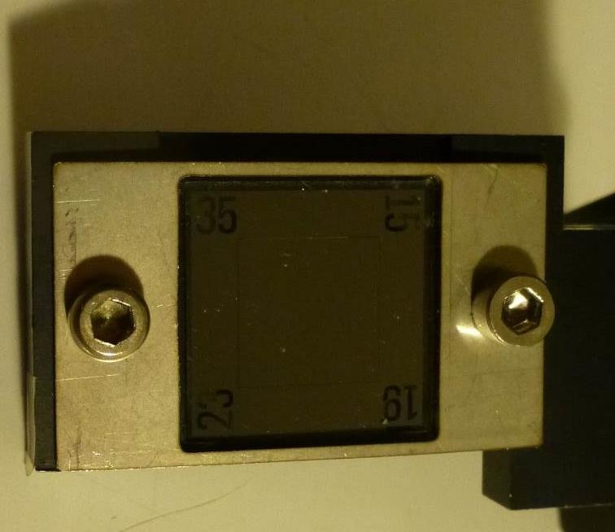
The slit environment
Optically polished component:
MUST HE HANDELED WITH CARE
Active slit
35 μm slit
15 μm slit
Slit holding plate
25 μm slit
19 μm slit

Slide 43
The slit environment
C1
Active slit:
15
19
Hole
Slit holding plate
35
25

Slide 44
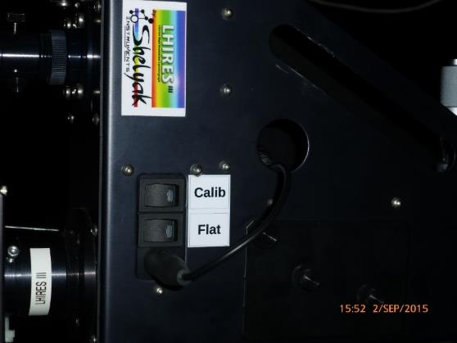
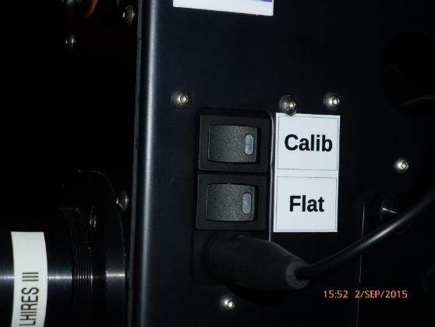
The calibration lamps
Spectral calibration lamp:
a small glass bulb filled with low pressure gases, producing
strong and well-defined emission lines when an
electric current passes through. Example Neon-Argon.
Goal: determine the pixel-wavelength relationship.
Flat calibration lamp:
A Tungsten filament bulb producing a “black body”
continuous spectrum.
Goal: determine the photometric throughput variations,
pixel by pixel.
Spectral calibration switch
Flat calibration switch
Power supply plug

Slide 45
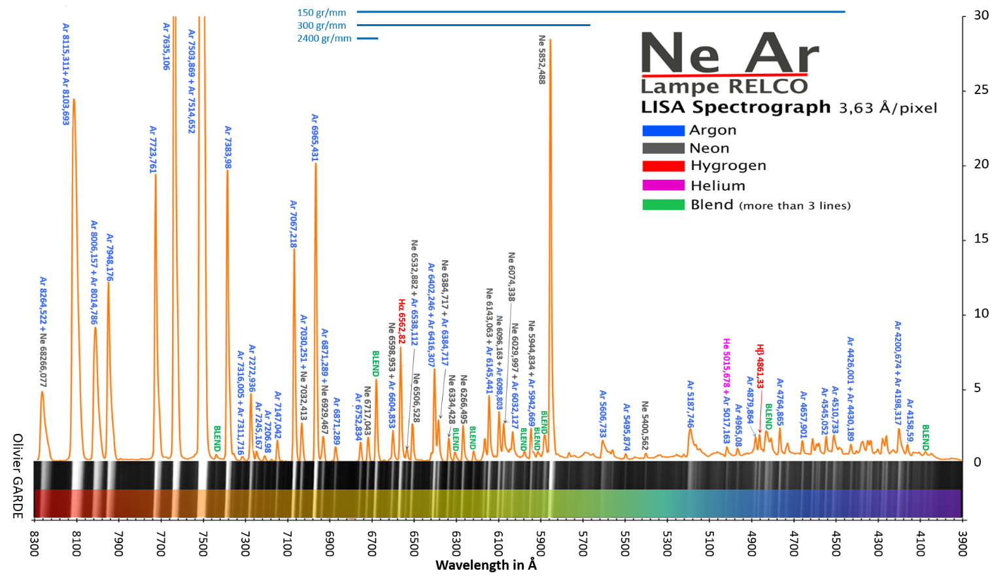
The Neon-Argon spectrum

Slide 46
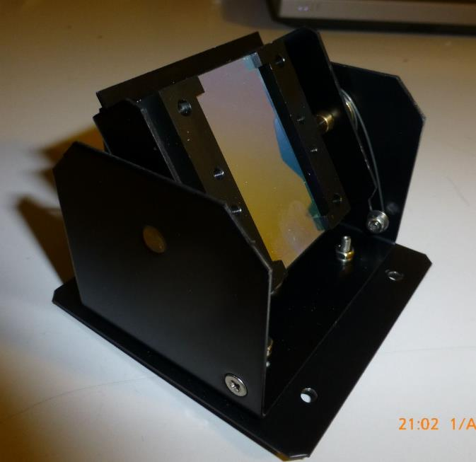
The diffraction gratings
Protection frame
Tilt axis
Active grating surface
Available gratings:
150 gr/mm
300 gr/mm
2400 gr/mm
Housing
High precision optical component:
MUST HE HANDELED WITH EXTREME CARE
NO FINGER PRINTS !

Slide 47
Spectral resolution
Available gratings:
150 gr/mm
300 gr/mm
2400 gr/mm
Available slits:
15 microns
19 microns
25 microns
35 microns
Spectral resolution @ 656.3nm (Hα)
 | 15 μm | 19 μm | 25 μm | 35 μm
150 gr/mm | 890 | 750 | 610 | 470
300 gr/mm | 1780 | 1510 | 1230 | 940
2400 gr/mm | 23000 | 19500 | 15900 | 12100
Slit
Grating
Conditions:
Telescope aperture ratio F/D = 9.0

Slide 48
Spectral range, spectral scale
Spectral range accessible on a single image, and spectral scale
@ 656.3nm (Hα)
Grating | Spectral range | Spectral scale
150 gr/mm | 230 nm | 0.30 nm/pix
300 gr/mm | 114 nm | 0.15 nm/pix
2400 gr/mm | 9 nm | 0.012 nm/pix
Conditions:
Science camera: SBIG ST402 (pix=9μm, Size=6.9mm)

Slide 49
PRACTICAL ISSUES

Slide 50
Preliminary adjustments
Operations to be done before the LHIRES-III is set on the telescope:
Guiding camera focusing.
Guiding camera orientation adjustment.
Science camera orientation adjustment.
Science camera focusing.
Micrometric screw pre-calibration.

Slide 51
Guiding camera focusing
Guiding optics should produce a
sharp image of the slit onto the guiding camera’s sensor.
Unfocused slit image
on the guiding camera
Focused slit image
on the guiding camera

Slide 52
Guiding camera focusing
Switch off all calibration lamps.
Use an external light source to light the slit through the telescope interface tube (2”).
Untighten the focus locking scroll wheel.
Untighten the 3 guiding camera lock screws.
Rotate the guiding camera mount while maintaining the guiding camera in an approximately fixed orientation, until the slit image on the guiding camera display appears sharp.
Tighten the focus locking scroll wheel.
Check that the slit image is still sharp.
Tighten the 3 guiding camera lock screws.
Light
source
Guiding camera
mount
Telescope
interface (2”)
Focus locking
scroll wheel
LHIRES-III
iNova
guiding
camera
Guiding camera
lock screws (x3)

Slide 53
Guiding camera orientation
Guiding
port
LHIRES-III
Telescope
interface (2”)
Science
port
iNova
guiding
camera
Camera orientation
angle adjustment
ST402
science
camera

Slide 54
Guiding camera orientation
Guiding optics should produce a
sharp image of the slit onto the guiding camera’s sensor.
Wrong orientation of the slit image
on the guiding camera
Correct orientation of the slit image
on the guiding camera

Slide 55
Guiding camera orientation
Switch off all calibration lamps.
Use an external light source to light the slit through the telescope interface tube (2”).
Untighten the 3 guiding camera lock screws.
Rotate the guiding camera in its mount, until the slit image on the guiding camera display appears parallel to the reticule’s horizontal line.
Tighten the 3 guiding camera lock screws.
Light
source
Guiding camera
mount
Telescope
interface (2”)
Focus locking
scroll wheel
LHIRES-III
iNova
guiding
camera
Guiding camera
lock screws (x3)

Slide 56
Science camera orientation
Guiding
port
Telescope
interface (2”)
Science
port
LHIRES-III
iNova
guiding
camera
ST402
science
camera
Camera orientation
angle adjustment

Slide 57
Spectral image geometry
Typical non-ideal spectral image
Sky background
Continuum
Absorption
lines
Emission
line

Slide 58
Spectral image geometry
slant angle
Spectral lines direction
Dispersion direction
tilt angle
Camera pixel rows orientation
Spectral lines curvature:
“smile”
Tilt: dispersion vs pixel rows. Depends on camera’s orientation w.r.t. grating.
Slant: spectral lines vs pixels columns. Depends on camera’s orientation w.r.t. slit.
Smile: spectral lines curvature. Depends on inner optical aberrations.

Slide 59
Spectral image geometry
Ideal spectral image
Tilt: = 0.
Slant: = 0.
Smile: = 0.

Slide 60
Science camera orientation
Guiding
port
Switch the Ne-Ar calibration lamp on.
Adjust the camera orientation angle should be set so that slant angle be ≈0
Tighten gently the camera positioning screws.
Tilt angle and smile will never be 0. They depend on the internal structure of the LHIRES-III. ⇒ Will be software-corrected.
Science
port
iNova
guiding
camera
ST402
science
camera
Camera orientation
angle adjustment

Slide 61
Science camera focusing
Littrow (collimation+camera) optics should produce a
sharp image of the slit onto the science camera’s sensor.
Unfocused spectral image
of the Ne-Ar calibration lamp
Focused spectral image
of the Ne-Ar calibration lamp
DON’T GET CONFUSED WITH THE TELESCOPE’S FOCUSING :
(tuning the telescope’s focus position so that stellar images
are sharply formed on the slit’s surface).

Slide 62
Science camera focusing
Switch the Ne-Ar calibration lamp on.
Remove the locking screw of the side flap.
Grab the handles of the flap and slide it so as to unlock it.
Remove the side flap.
Do the same on both sides.
iNova
guiding
camera
Screw
ST402
science
camera
Lateral flap
Handles
(do not unscrew)

Slide 63
Science camera focusing
Unlock nylon screws on both sides.
Adjust the focus scroll wheel to have sharp spectral lines on the camera display.
Lock the nylon screws on both sides.
Check the line’s sharpness.
Close the flaps on both sides.
iNova
guiding
camera
Nylon locking screw
Littrow optics
barrel
ST402
science
camera
Focus scroll wheel

Slide 64
The micrometric screw to adjust the grating angle
How to read the
micrometric screw :
Micrometric screw
Useful to select the
central wavelength !
Value = 23.5+0.34 = 23.84
Drum tick mark
in front of the
fixed index : 34
45
40
35
30
25
Last visible
mark: 23.5
20
Fixed index
15
Active grating surface
10
Half-integer
tick marks
Integer
tick marks
5
Fixed tilt axis
0

Slide 65
Micrometric screw calibration
For further on-sky operations, we need a coarse relationship between the micrometer reading and the central wavelength on the science spectroscopic image.
3.25
3.20
3.15
3.10
Micrometer (mm)
Micrometric screw
3.05
3.00
2.95
2.90
2.85
4500
5000
5500
6000
6500
7000
7500
Wavelength (Å)

Slide 66
Micrometric screw calibration
Switch the Ne-Ar calibration lamp on.
Screw the micrometer almost entirely, until a very bright single line appears.
Put this line (zeroth order) in the middle of the science camera image, and read the micrometer’s position.

Slide 67
Micrometric screw calibration
Unscrew the micrometer until several spectral lines appear (first order).
Try to recognize a given spectral line (e.g. the 6344.43Å line) from the calibration lamp’s spectral atlas (available upon request).
Put this line in the middle of the science camera image, and read the micrometer’s position. Store the couples [wavelength-micrometer reading] in a spreadsheet (template available upon request).
6334.43Å line
6334.43Å line

Slide 68
Micrometric screw calibration
Do it again for as much lines as possible.
Compute the best fitting polynomial by a least square method. A first order polynomial is often sufficient.
This pre-calibration relationship will serve during on-sky observing sessions, to find the micrometer position to choose, in order to have the wanted spectral region in the center of the spectral image.
3.25
3.20
3.15
3.10
Micrometer (mm)
3.05
3.00
2.95
2.90
2.85
4500
5000
5500
6000
6500
7000
7500
Wavelength (Å)

Slide 69
Typical observing session
Point the telescope to the first science target.
Switch the Tungsten calibration lamp on, and record 5 flat frames.
Switch the Tungsten calibration lamp off. Switch the Ne-Ar calibration lamp on, and record 1 spectral calibration frame. Switch the Ne-Ar calibration lamp off.
Record science frames for at most 15 minutes.
Record 5 flat frames and 1 spectral calibration frame (see items 2 and 3).
Point the telescope to a spectral reference star (e.g. Vega; list available upon request), as close as possible to the science target.
Record 5 science frames on the reference star (as in item 4).
Loop back to item 2, or to item 1 for a new science target.

Slide 70
Observing log
FILE HEADER:
LHIRES-III OBSERVING LOG
Date : 2017/02/15
Observers : Jean DUPONT, Michel DUPOND.
Telescope : Epsilon@C2PU (OCA)
Instrument : LHIRES-IIIa
Science camera: SBIG ST402 FW
Guiding camera: iNova PLB-Mx
OBSERVING RUN NUMBER 01 ---------------------------------------
.
.
---------------------------------------------------------------
OBSERVING RUN NUMBER 02 ---------------------------------------
.
.
---------------------------------------------------------------

Slide 71
Observing log
OBSERVING RUNS:
OBSERVING RUN NUMBER 01 ---------------------------------------
Target : Jupiter
Reference star : Vega
Grating : 150 tr/mm
Micrometer : 03.16mm
Central wavelength : 656.3nm
Telescope on target: 22:30:00 UT
22:30:30 UT
05 Tungsten flat frames. Exp=0001s000
22:30:50 UT
05 Argon-Neon calibration frames. Exp=0000s100
22:31:00 UT
10 science frames on Ref. star Exp=0000s500
22:32:00 UT
05 Tungsten flat frames. Exp=0001s000
22:32:30 UT
05 Argon-Neon calibration frames. Exp=0000s100
22:33:10 UT
10 science frames on target. Exp=0000s500
.
.
.
22:35:50 UT
---------------------------------------------------------------

Slide 72
European South Observatory
REFERENCE SPECTRA

Slide 73
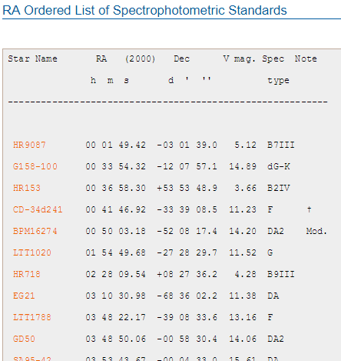
ESO reference spectra
Right ascension-ordered list of standards:
https://www.eso.org/sci/observing/tools/standards/spectra/stanlis.html
Click the name
of the selected star

Slide 74
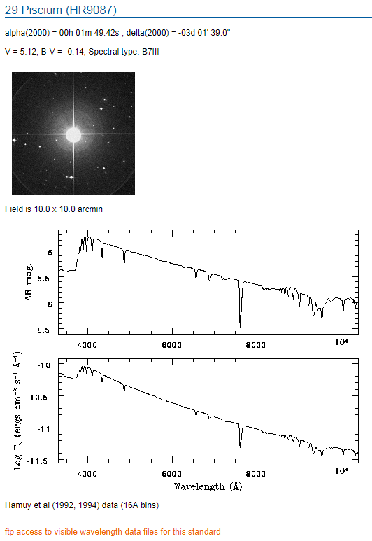
ESO reference spectra
Basic informations
on the star:
Coordinates
Magnitudes, spectral types
Finder
AB mag. spectrum
Flux spectrum
Go to FTP server to download

Slide 75
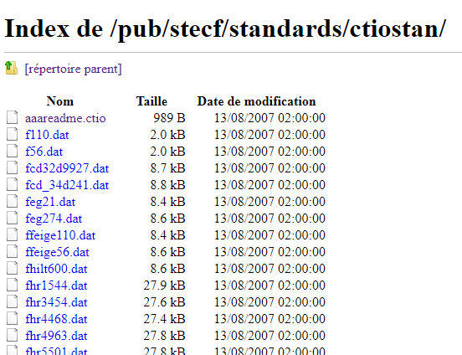
ESO reference spectra
FTP for downloading standard spectra:
ftp://ftp.eso.org/pub/stecf/standards/ctiostan/
Click the name
of the selected star

Slide 76
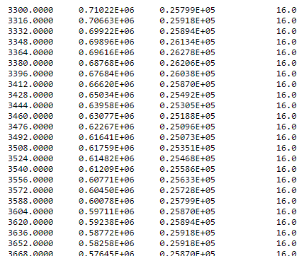
ESO reference spectra
Spectral data:
Wavelength (Å)
f-prefixed files
(ex: “fhr9087.dat”):
Flux (ergs/cm²/s/Å x 10¹⁶)
Flux (milli-Jansky)
Bin size (Å)
1 Jansky = 10⁻²⁶ W m⁻² Hz⁻¹

Slide 77
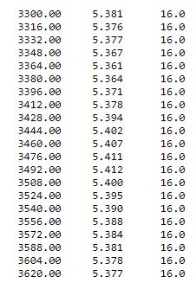
ESO reference spectra
Spectral data:
Wavelength (Å)
m-prefixed files
(ex: “mhr9087.dat”):
AB magnitude
Bin size (Å)
m_{AB}=-2.5×Log₁₀( Flux / 3631Jy )

Slide 78
SAMPLE SPECTRA

Slide 79
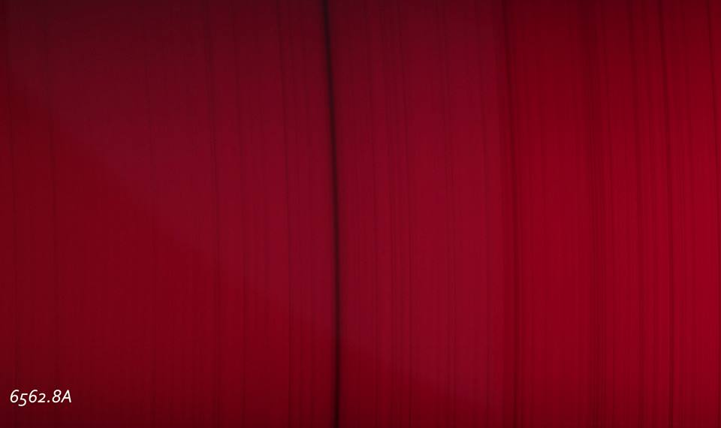
Solar spectrum
The Hydrogen “Hα” line (LHIRES-III + 2400 gr/mm)

Slide 80
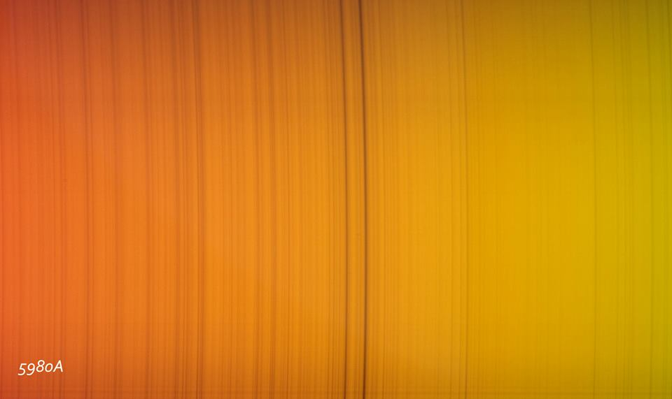
Solar spectrum
The Sodium D1 and D2 lines (LHIRES-III + 2400 gr/mm)

Slide 81
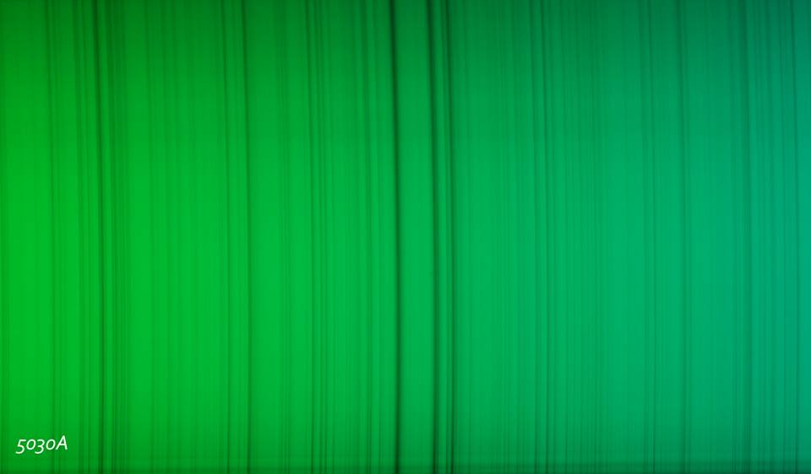
Solar spectrum
The Magnesium triplet (LHIRES-III + 2400 gr/mm)

Slide 82
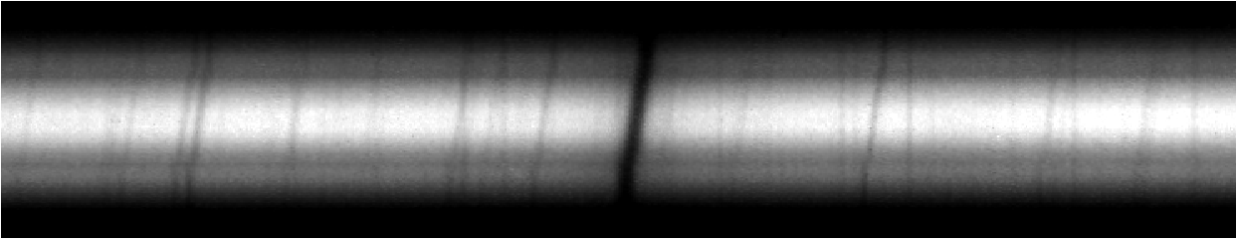
The rotation of saturn
The Hydrogen Hα line in Saturn’s spectrum (LHIRES-III + 2400 gr/mm)
The lines are tilted by the planet’s surface rotation (Doppler effect)

Slide 83
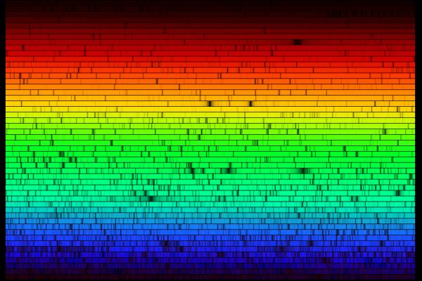
END

