Slide 1
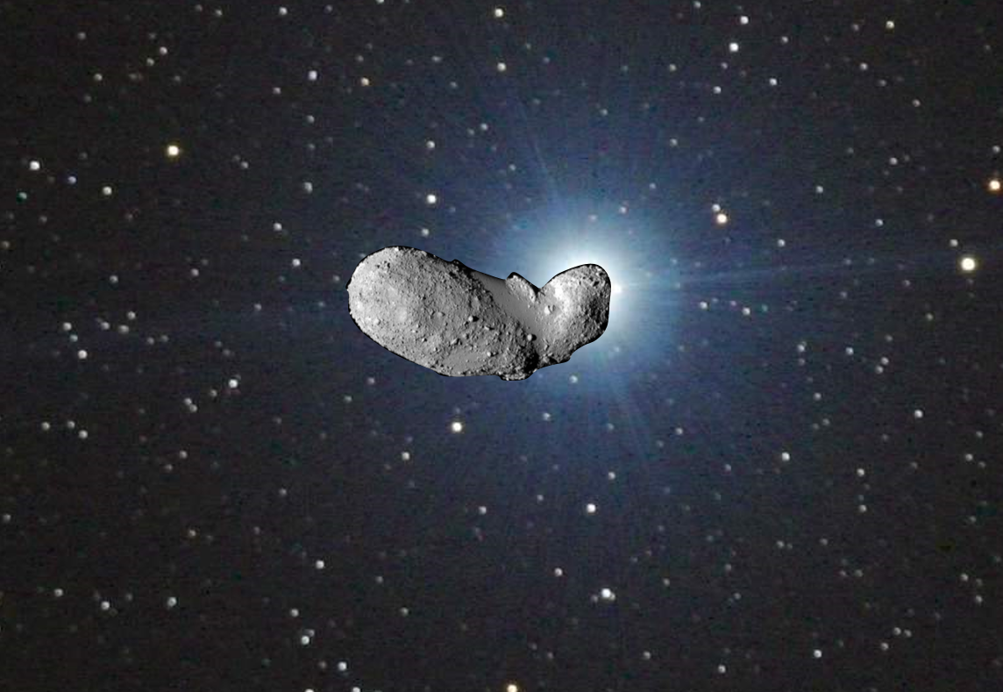


STELLAR
OCCULTATIONS
Version 01, 14/10/2016
© C2PU, Observatoire de la Côte d’Azur,
Université de la Côte d’Azur
Notes:
Conférence présentée à PARSEC, le 1er octobre 2005.

Slide 2
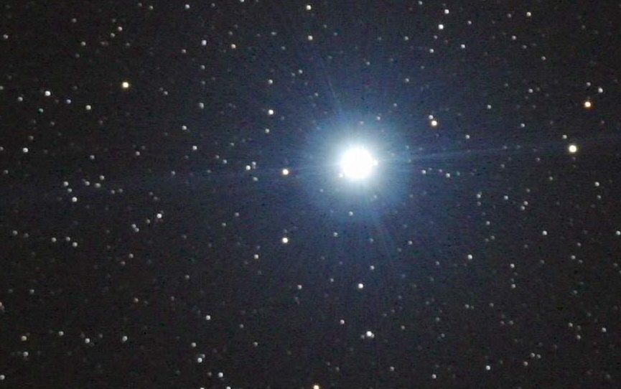
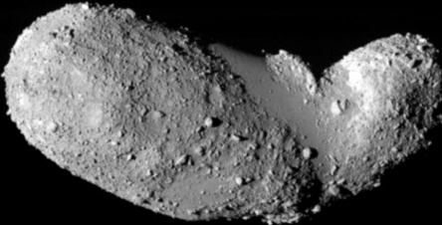
The principle
C1
Wait until the asteroid passes in front of a bright star...
Star light is dimed during
a short moment.

Slide 3


Stellar shadow
Asteroid
Shadow of the asteroid
at a given instant
Star light

Slide 4
Stellar shadow path
Asteroid
The shadow of the
asteroid “sweeps” a
strip of Earth’s surface.
Shadow of the asteroid
at a given instant
Asteroid’s trajectory
Trajectory of
the shadow

Slide 5
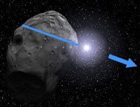
Occultation with several stations
C1
Asteroid’s shadow passes over all three observatories in sequence, and dims the star light at different instants and for a different durations.
Asteroid
Shadow of the asteroid
at a given instant
Observatory 1
Observatory 2
Observatory 3
from http://www.euraster.net/guide/01.html (Eric Frappa)

Slide 6
Occultation with several stations
Chord from
Observatory 1
Asteroid
Shadow of the asteroid
at a given instant
Chord from
Observatory 2
Chord from
Observatory 3
Observatory 1
Flux
t₁
t₂
time
Observatory 2
Flux
t₁
t₂
time
Observatory 3
Flux
t₁
t₂
time

Slide 7
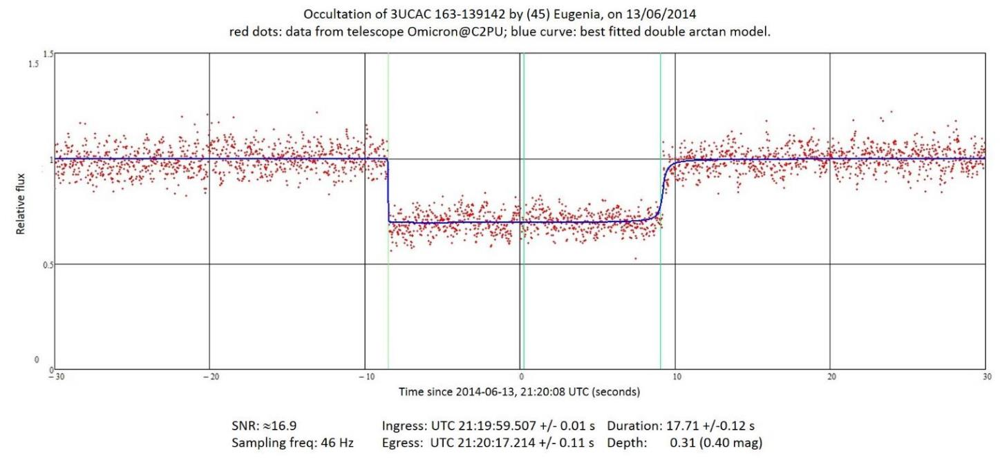
A typical occultation lightcurve
Occultation of star 3UCAC 163-139142 by asteroid (45) Eugenia,
recorded on June 13th 2014 from C2PU
Mv=12.2, exposure time: 0.02 s RSB=17

Slide 8
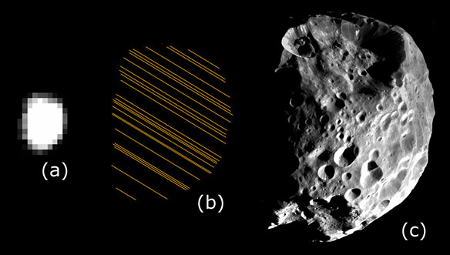
Efficiency assessment
from http://www.euraster.net/guide/01.html (Eric Frappa)
Example: a 200 km asteroid at 300 millions km from Earth.
(a) observed from the VLT (8m) + adaptive optics. Space resolution : ~ 60 km,
(b) observed by stellar occultation (25 observers). Space resolution : ~ 1 km,
(c) observed in situ by a space probe. Space resolution : ~ 15 m.

Slide 9
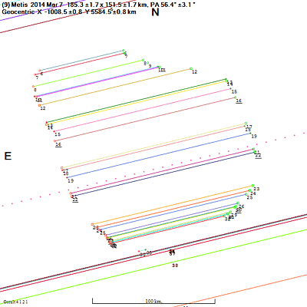
The shape of (9) Metis
Example 1:
Occultation of star HIP78193
by asteroid (9) Metis,
observed on March 7th, 2014
by 45 observers.
Result:
Size: 185.3 × 151.5 km ± 1.7 km
from http://www.euraster.net/guide/01.html (Eric Frappa)

Slide 10
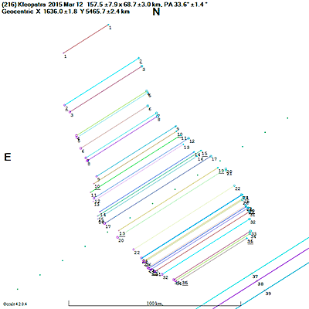
The shape of (216) Kelopatra
Example 2:
Occultation of star HIP54599
by asteroid (216) Kleopatra,
observed on March 12th, 2015
by 51 observers.
Result:
Size: 157.6 × 68.7 km ± 8 km
from http://www.euraster.net/guide/01.html (Eric Frappa)

Slide 11
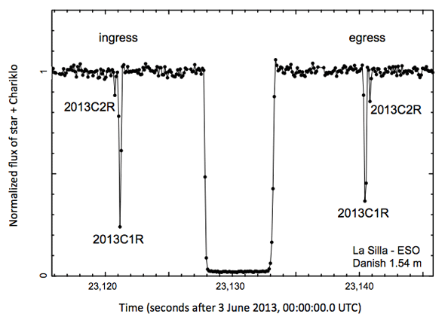
The shape of (10199) Chariklo
Example 3:
Occultation of star 2UCAC15096659
by asteroid (10199) Chariklo,
observed on June 3rd, 2013
by 8 observers.
Light curve from the Danish 1.54 m
telescope at La Silla, Chile.

Slide 12
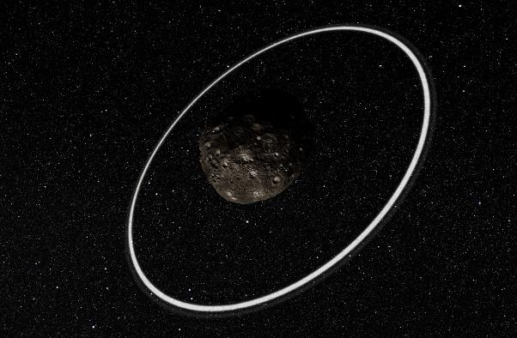
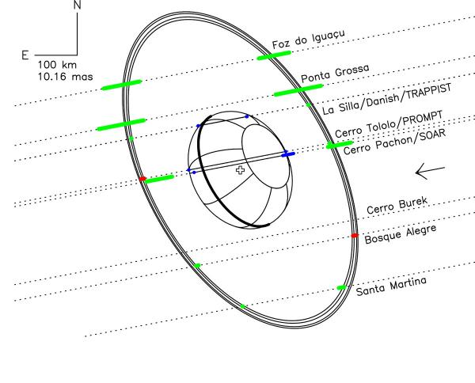
The Lord of the Ring
Result:
(10199) Chariklo has a ring !
(Artist’s impression)

Slide 13
Summary
Requires accurate absolute timing (GPS).
Requires a fast camera (several FPS).
Does NOT require big telescopes !
Requires a coordinated network of observers.
Gives informations about the size.
Gives informations about the projected shape,
if several observers.
An example of coordinated observers network: http://www.euraster.net/

Slide 14
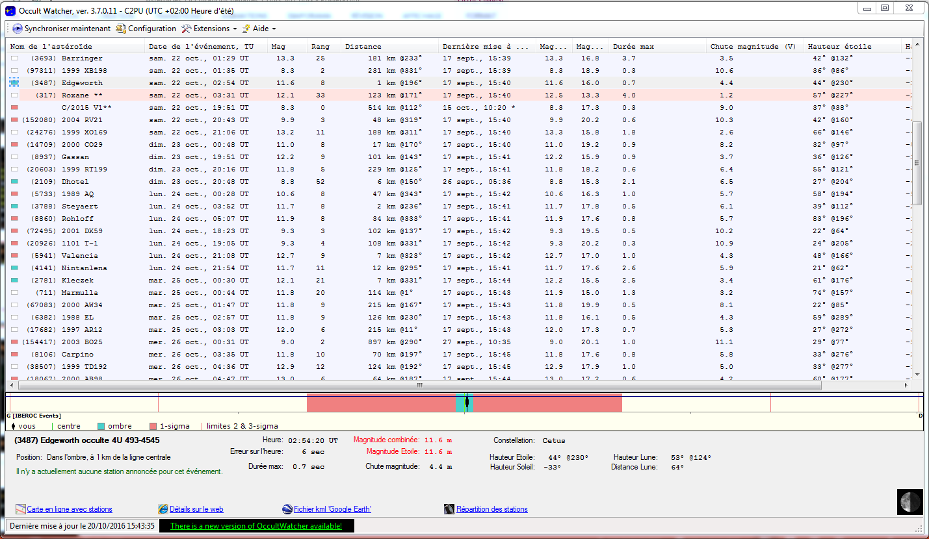
Where to find opportunities ?
OccultWatcher (free software; download from http://www.occultwatcher.net/publish.htm/ )

Slide 15
Main display
Menu bar
List of forthcoming events
Graphical description
Detailed description

Slide 16
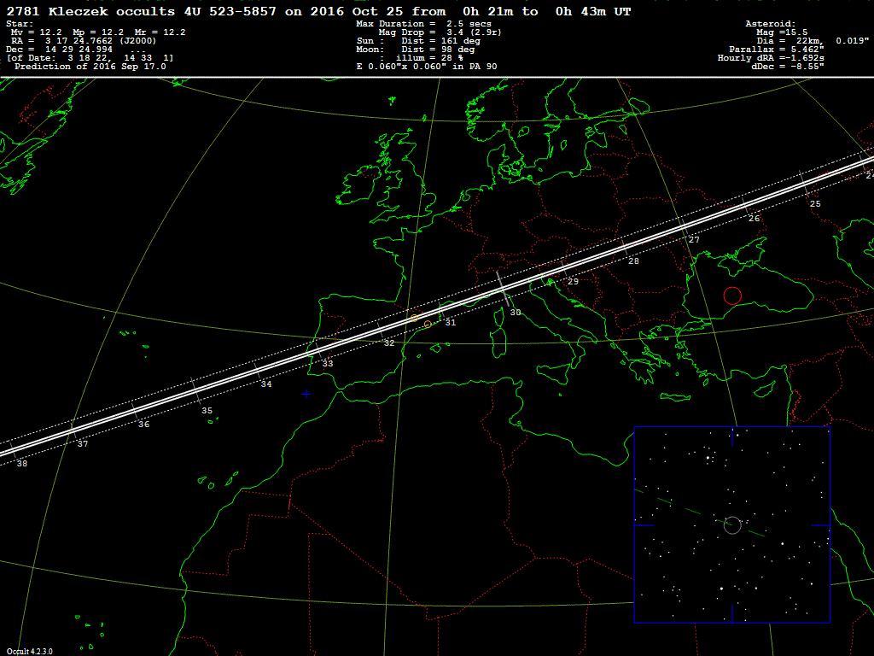
Reading prediction maps
Header
Map
2º×2º finder chart

Slide 17
Header
Asteroid
Star
Date
Time (UT)
Star parameters
column
Event parameters
column
Asteroid parameters
column

Slide 18
Prediction map
Shadow’s position
every minute

Slide 19
Finder chart
Occulted star
Asteroid’s trajectory
2°
2°

Slide 20
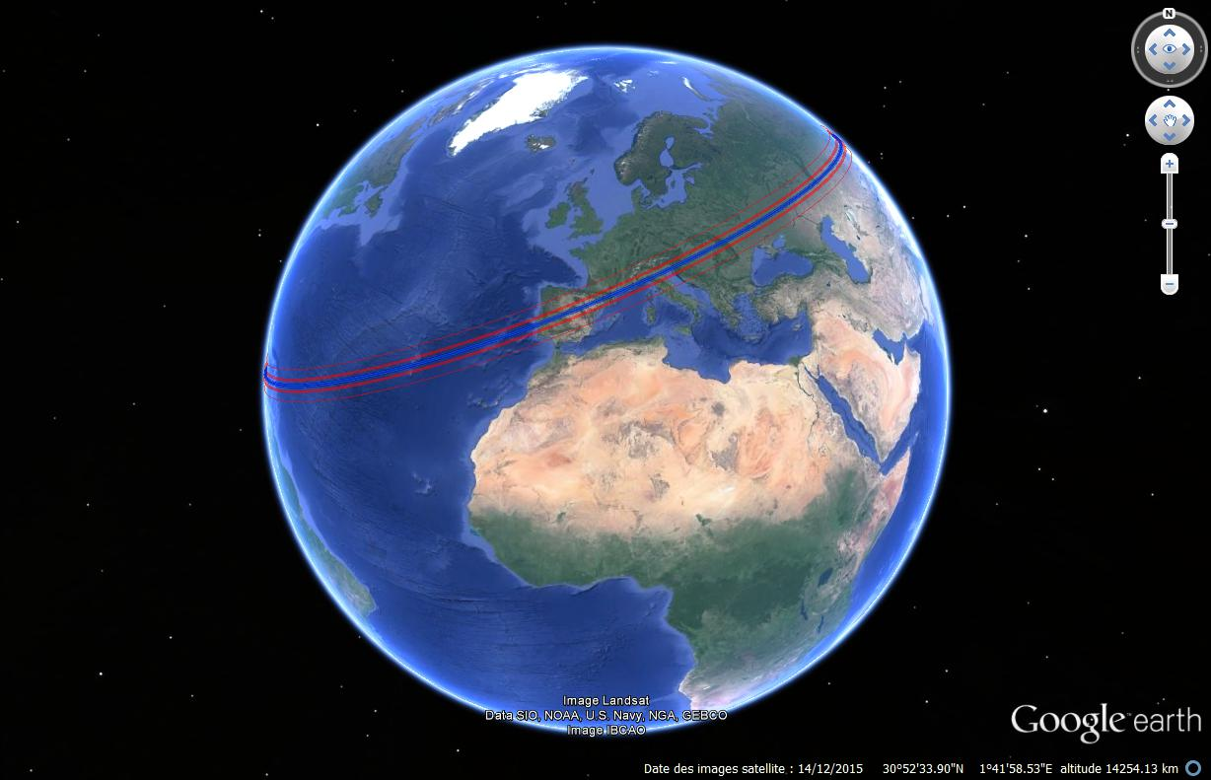
Google maps

Slide 21
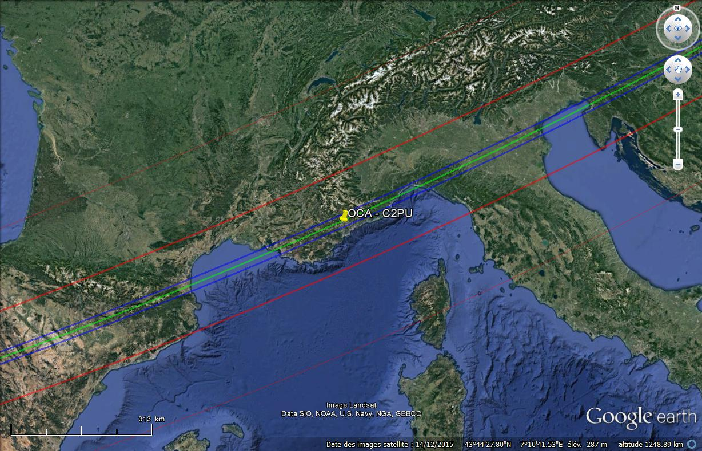
Google maps
Theoretical central line
Theoretical shadow limits
+/- 1 σ limits

Slide 22
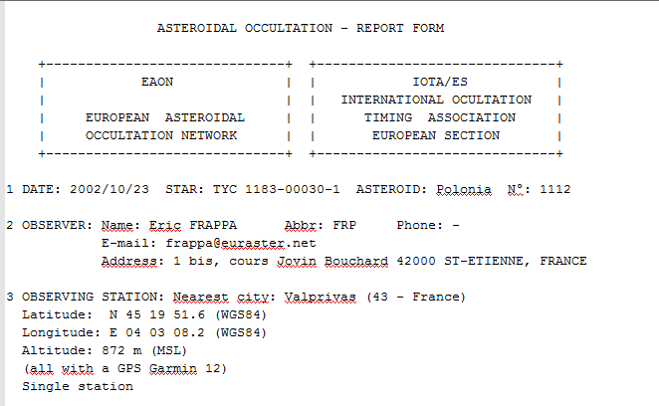
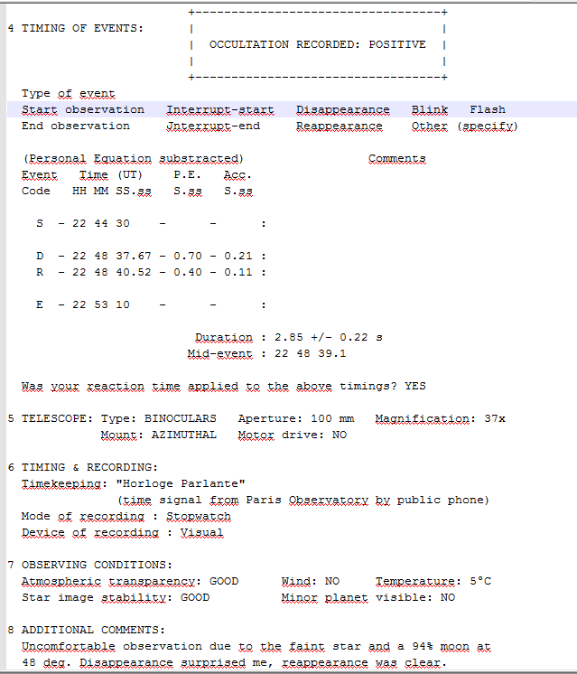
Observation reporting
IOTA report for observation with visual timing
IOTA:
International Occultation Timing Association

Slide 23
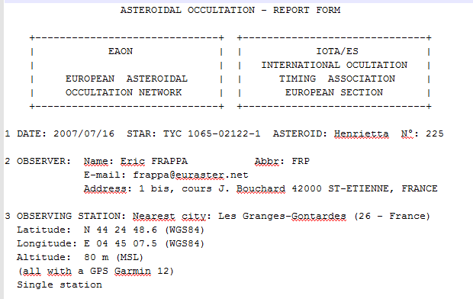
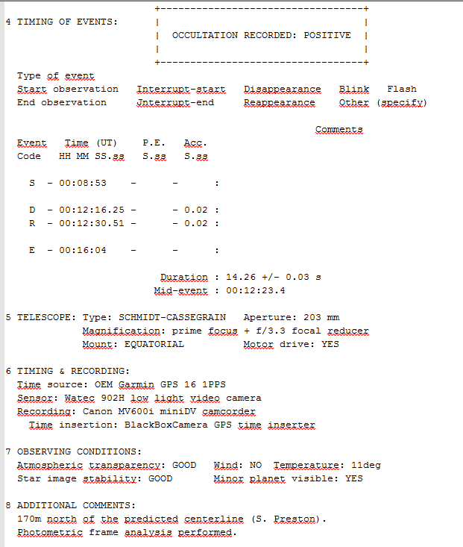
Observation reporting
IOTA report for observation with electronic timing
IOTA:
International Occultation Timing Association

Slide 24
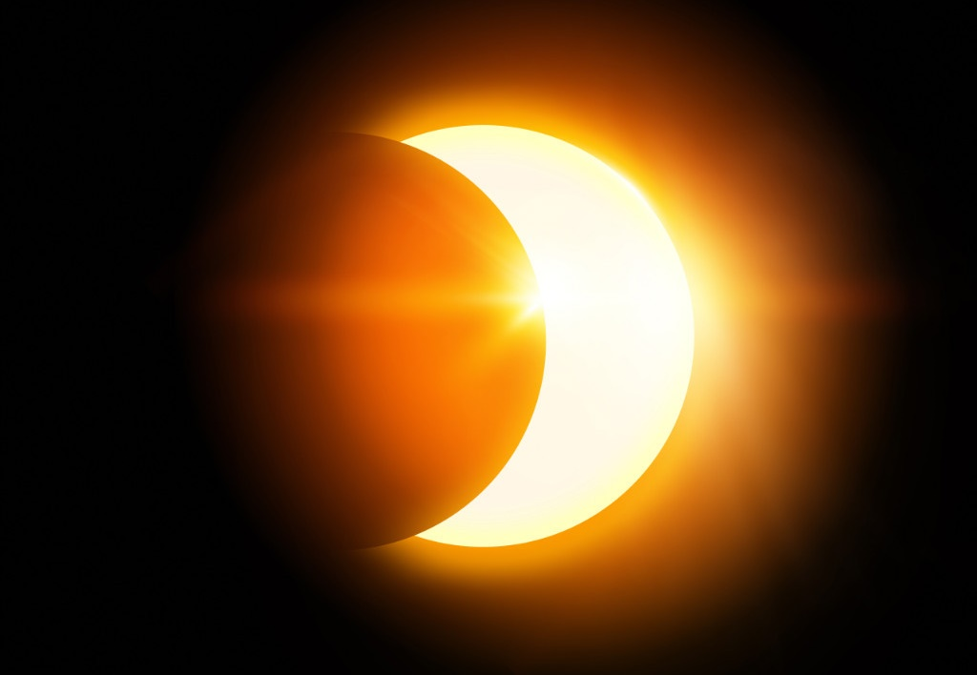
END

